Slide 1
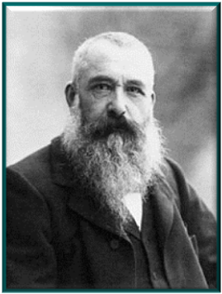
Claude Monet
Art Ambassador:
The
Life Cycle of the Frog or Lily Plant
By Teri Allart

Slide 2
ARE YOU FAST ? Let’s Have (3) Drawing Races
Color as FAST as you can!
START IN THE MIDDLE OF THE FILTER
Write your name on the edge of the coffee filter with the permanent marker.
Take your 1st color and scribble (a little bit larger) around the center black scribble.
Pick a 2nd color and scribble around the first two scribbles.
Pick a 3rd color and do it one more time.
Once you’re done, put your colored filter on “WORK PLATE” and RAISE YOUR HAND A Parent Volunteer will come over to squirt it 4-5x and you can WATCH the colors move & mix !

Slide 3
Impression
Art Ambassador :
What does “impression” mean ???
It’s what someone thinks about something.
It’s also how someone views something.
What is your impression of Ms. Clayton our Principal?

Slide 4
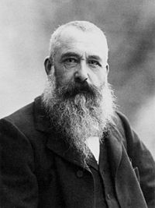
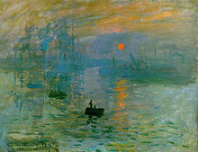
Claude Monet
Born in Paris France in 1840 (about 170 years ago).
He would paint as FAST as he could so as to capture the moment of the day, the exact lighting and how it felt to be there.
1899 photo
At a very young age, Monet knew he wanted to be an artist. He would go to the biggest art museum in the world called the Louvre (Paris). He saw painters trying to learn how to paint, by copying the paintings on the walls .
Monet didn’t want to do that! He didn’t want to sit in a museum and copy the pictures. So, he would go outside or sit by a window and paint what he saw!
1872 Impression, Sunrise
He created a painting style called
“IMPRESSIONISM”
He would paint how things looked to him.

Slide 5
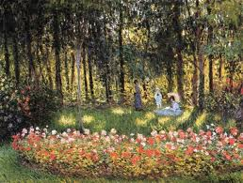
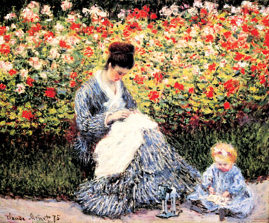
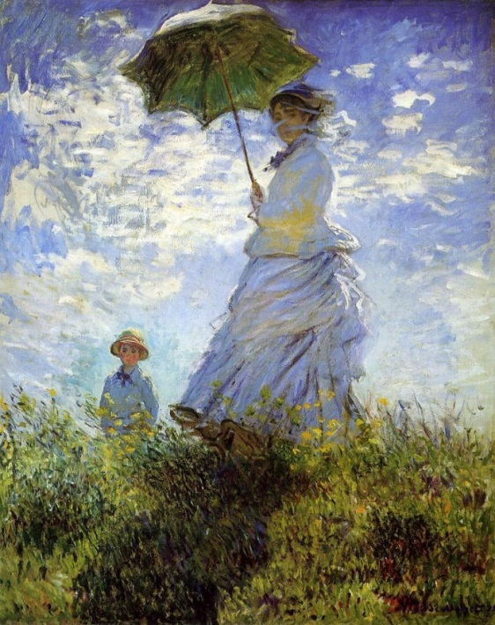
The Artists’ Family in the Garden
Monet’s Impressionist Style:
He would paint very quickly, using fast, choppy paint strokes. We can’t really see the details of their faces.
He loved to paint happy things, children playing, flowers, people having a good time.
Monet used bright colors like red, blue, yellow or striking colors like green and purple.
Woman with a Parasol 1875

Slide 6
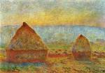
Haystacks
Monet often painted the same thing over and over again to show how the same place or object would look as the light changed during a day.
He would also paint the same thing at different times of the year. Each of his paintings, would look very different.

Slide 7
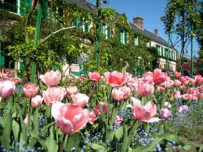
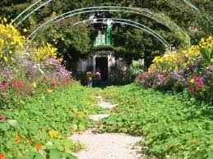
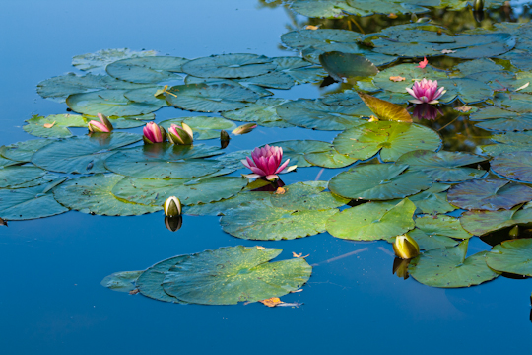
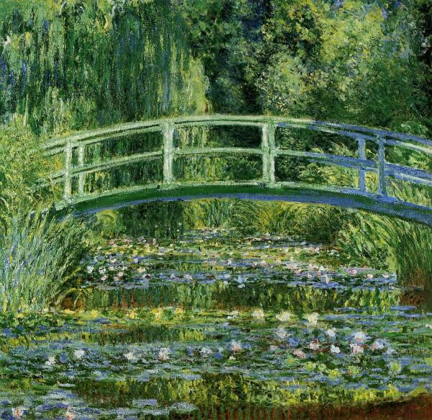
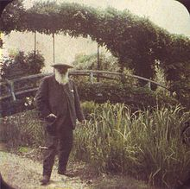
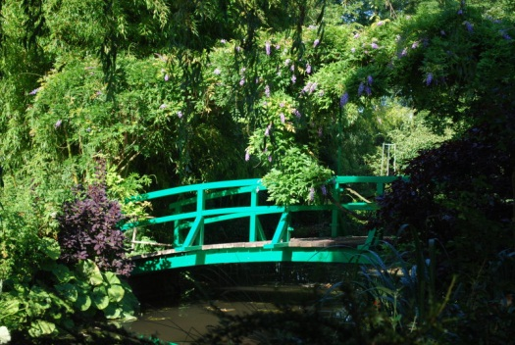
Monet’s favorite place to paint…
his home in Giverny
The Japanese Bridge 1899
He created beautiful gardens and ponds around his home and these were among his favorite scenes to paint.
For almost 30-years, Monet painted his flower gardens, his ponds filled with lilies, and his famous Japanese bridge.
Photo of Monet’s Bridge 2009
Photo of Monet in his garden 1917

Slide 8
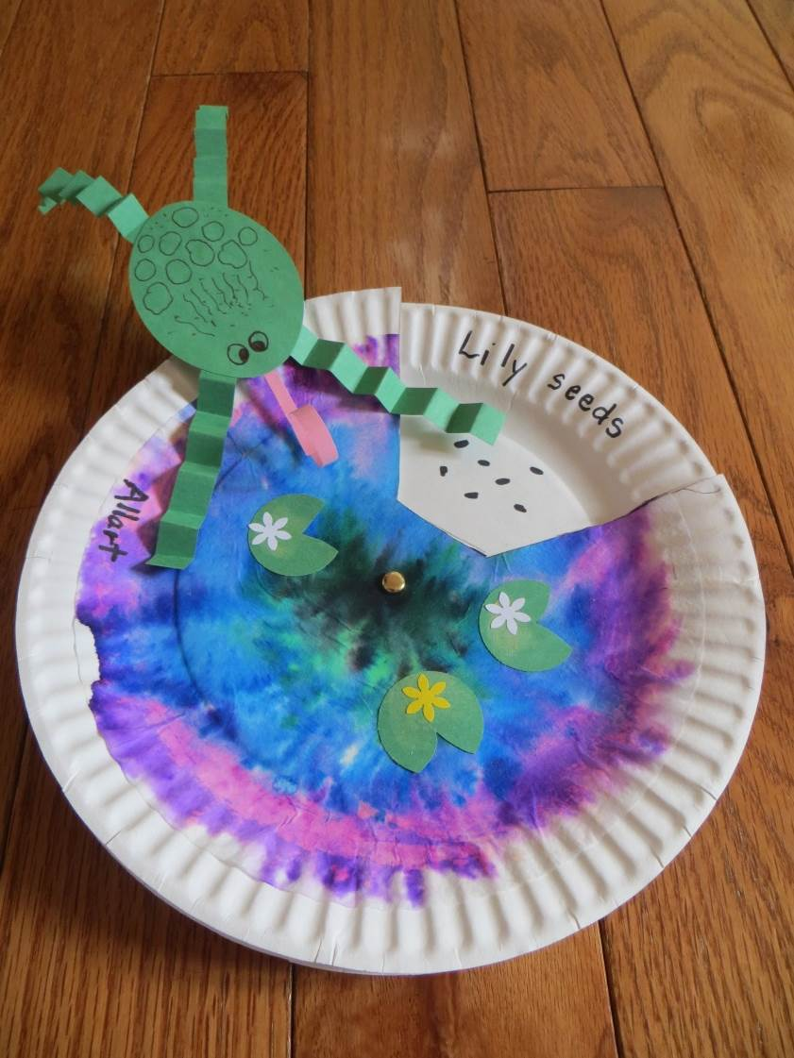
Mini Monet
Art Ambassador Project:
YOU WILL NEED:
Glue stick
Pencil
Colored Pencils
YOU WILL RECEIVE:
Frog Kit
Life Cycle Plate
Black Ink Pen
Step 1:
YOU ALREADY DID IT ! You painted a pond in the FAST painting style of Monet !

Slide 9
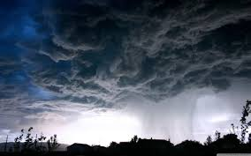
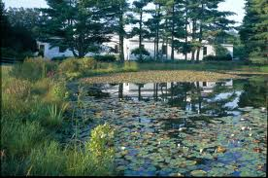
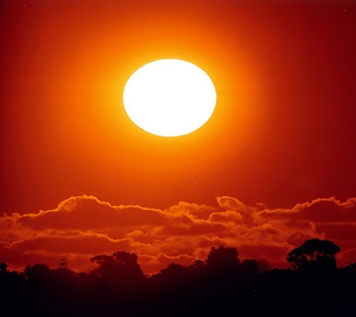
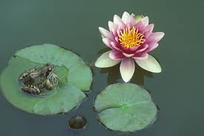
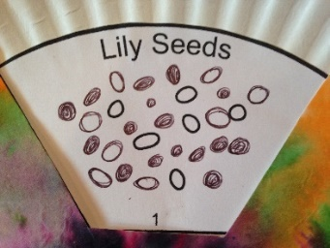
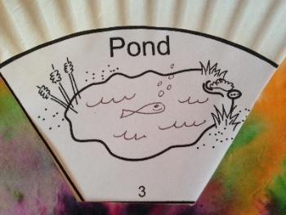
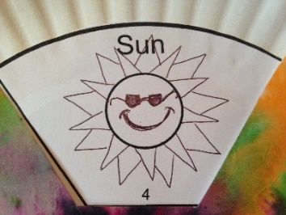
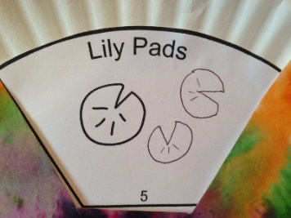
Step 2: DRAW your “Impression” of the Lily Plant Life Cycle in 5-steps (10 minutes)
Step #1:
Lily Seeds
Step #2:
Rain Clouds
Step #3:
Pond
Step #4:
Sun
Step #5:
Lily Pads
With a BLACK INK PEN
complete the drawing
Draw 10 more Lily Seeds.
They can be either small circles or ovals.
With a BLACK INK PEN
complete the drawing
Draw a few more rain clouds.
Add some rain drops.
Maybe add some lightning?
With a BLACK INK PEN
complete the drawing
Draw some fish in your pond.
Maybe add some waves to the water.
With a BLACK INK PEN
complete the drawing
Draw a Sun with some rays.
Add a smile.
Maybe add some cool sunglasses!
With a BLACK INK PEN
complete the drawing
Draw a couple more Lily Pads.
They look like Pac-Man!

Slide 10
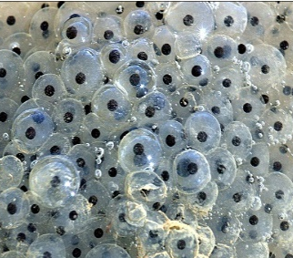
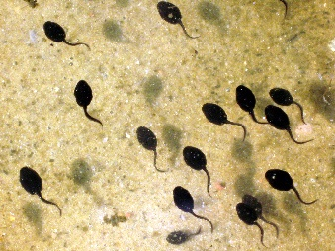
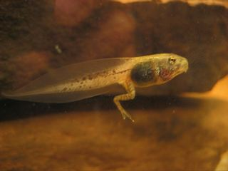
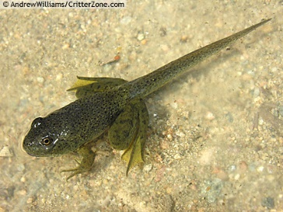
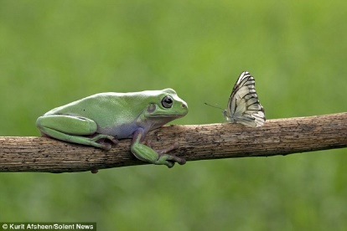
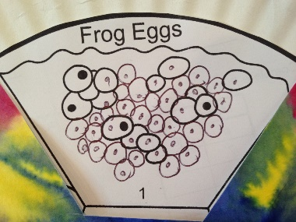
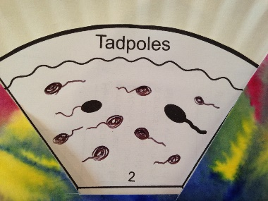
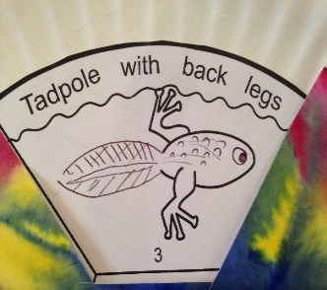
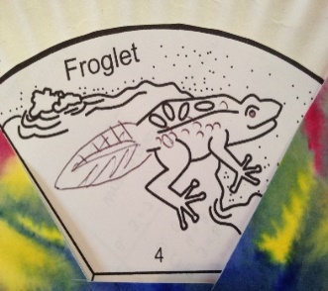
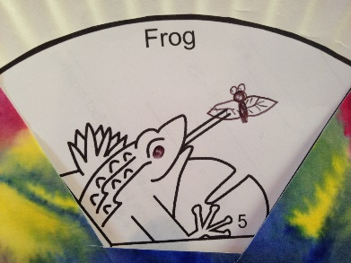
Step 2: DRAW your “Impression” of the Frog Life Cycle in 5-steps (10 minutes)
Step #1:
Frog Eggs
Step #2:
Tadpoles
Step #3:
Tadpole with
back legs
Step #4:
Froglet
(young frog)
Step #5:
Adult Frog
(hungry)
With a BLACK INK PEN
complete the drawing
Add 10-15 more frog eggs. Draw circles like the ones you see.
Add one black dot to every egg you draw.
Make sure every egg has a black dot. This is where the baby frog grows from!
With a BLACK INK PEN
complete the drawing
Add 10-15 more tadpoles. They look like an oval with a squiggly tail.
Feel free to draw as many Tadpoles as you’d like.
With a BLACK INK PEN
complete the drawing
Add a BIG tail to the tadpole.
Add some bumps and dots to his tail.
Maybe draw an eye.
Add a smile!
With a BLACK INK PEN
complete the drawing
Your froglet is getting bigger every day. They can now leave the water and soon their tail will disappear! So, draw a SMALLER tail on your froglet.
Draw an eye.
Add some warts, bumps, and ridges to his back and body.
With a BLACK INK PEN
complete the drawing
Draw something good for your Frog to eat!
Maybe draw a fly, a dragonfly, or something yummy.
Draw an eye.
Add some warts, dots, and some bumps!

Slide 11
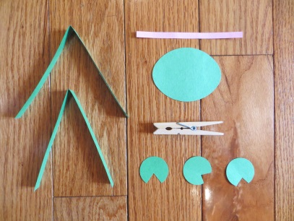
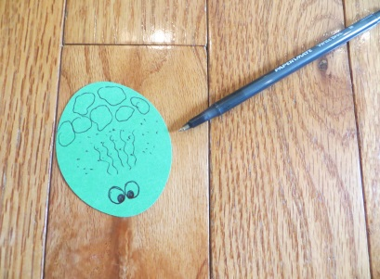
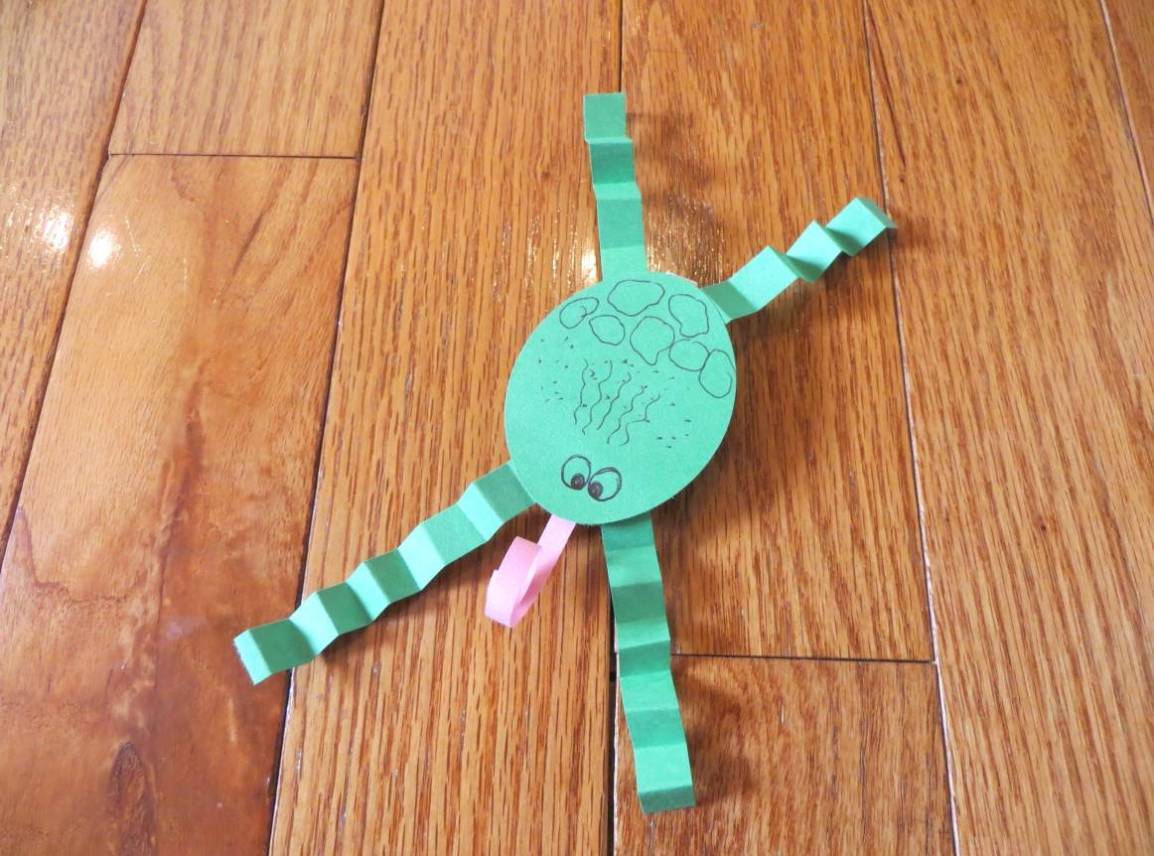
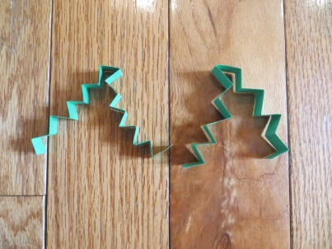
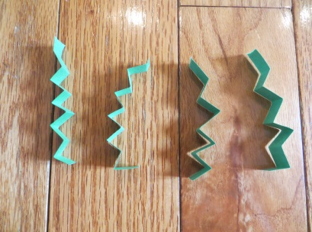
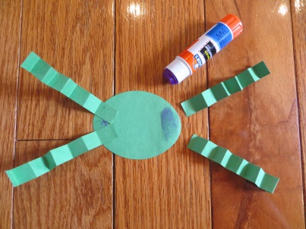
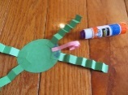
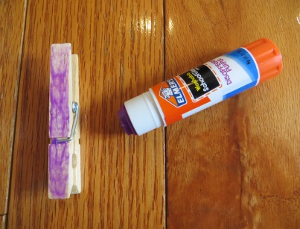
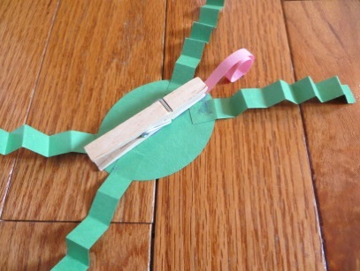
Create a frog who will live in your water garden!
Step 3:
YOU WILL NEED: Glue Stick and pencil
1
2
9
3
4
5
6
7
8
10
CLIP YOUR FROG to your TOP PLATE
(approximately 10-15 minutes)

Slide 12
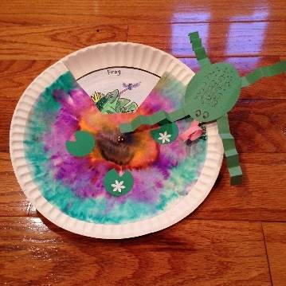
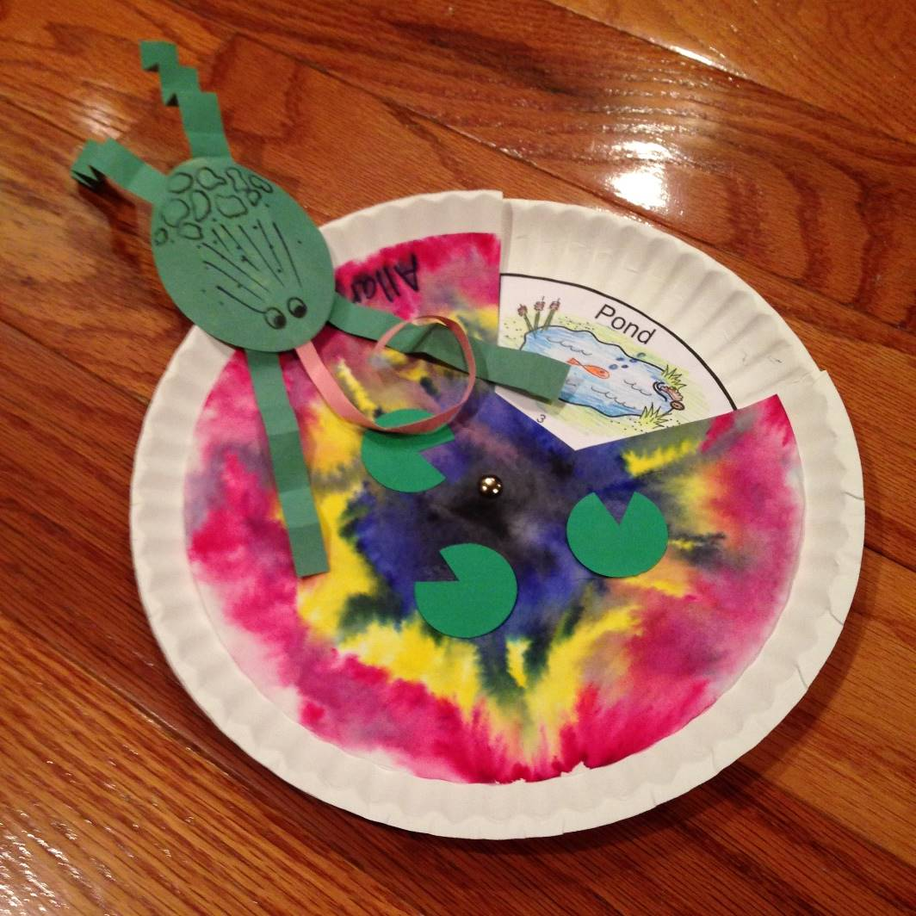
Art Ambassador:
ENJOY YOUR
MINI MONET !
IF WE HAVE TIME
Get some
COLORED PENCILS
and color in the
5-cycles of your
Frog or Lily Plant
(your bottom plate)

