Slide 1
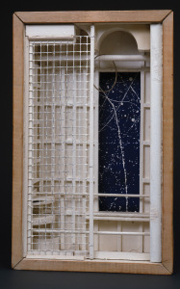
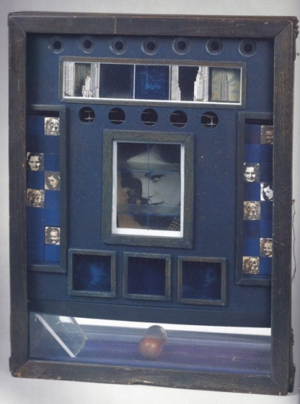
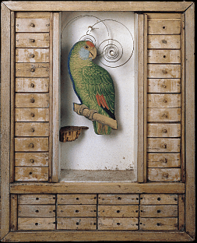
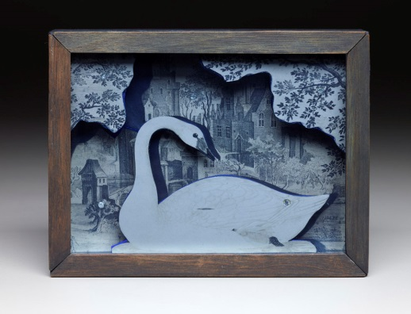
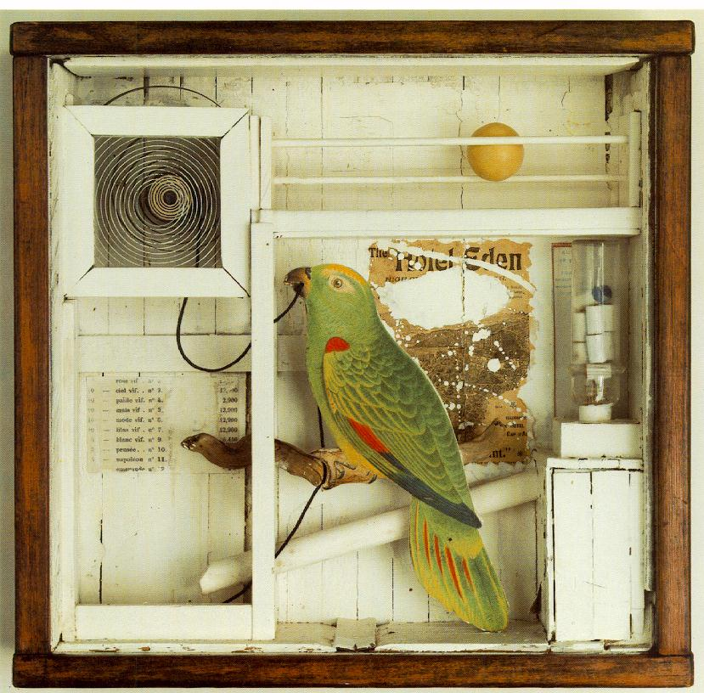
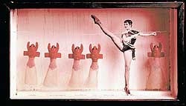
Joseph Cornell Assemblage Artist
Lauren Bacall Penny Arcade
Observatory Box
By: Teri Allart
Lobster Ballet Box

Slide 2
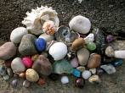
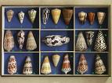
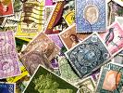
Collections…
People collect lots of different things… rocks, seashells, stamps, coins, buttons or even a souvenir from a trip as a memory.
What do you collect?

Slide 3
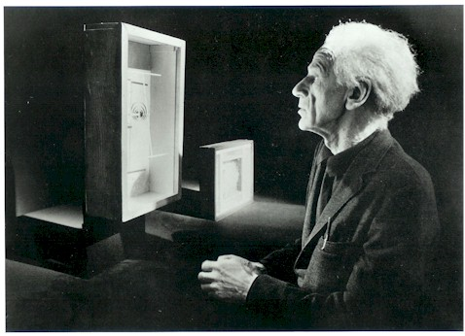
Cornell forever changed the concept of the box, from a functional everyday container, into a new art form.
Joseph Cornell was an American artist who made beautiful pieces of art by arranging his surprising collections inside simple glass-paned boxes.
They called his art form “Assemblage”
You have to use your imagination when you look at his mysterious miniature worlds inside of a box.

Slide 4
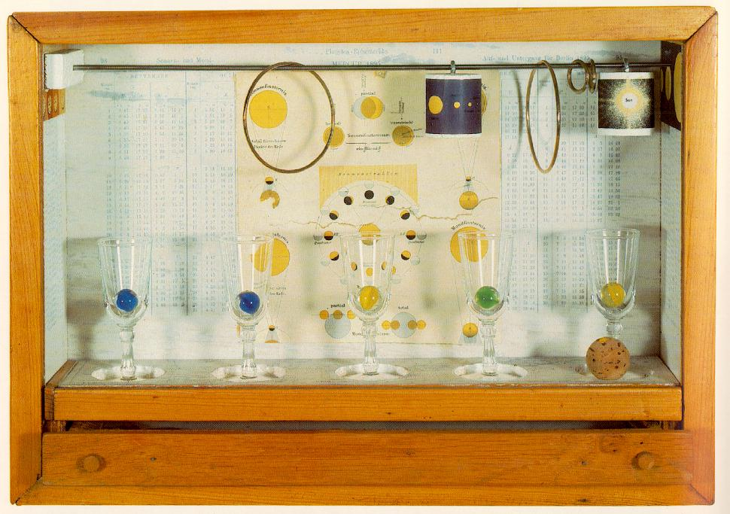
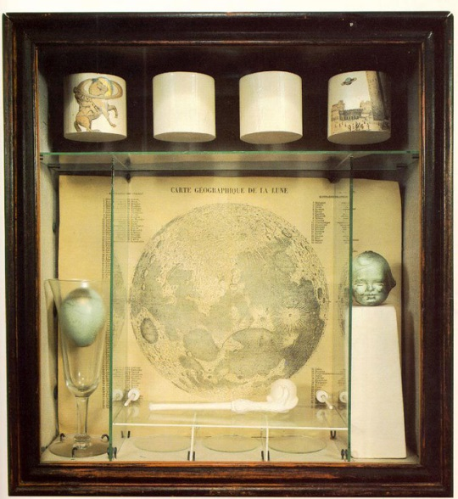
Untitled
(Solar Set) 1956-1958
Many of his items were just bits he found, someone else’s junk… but it would inspire him to make something NEW from nothing.
Blue marbles look like Earth
Circles look like planets
Untitled (Soap Bubble Set) 1936
Cornell spent a lot of time thinking about his subjects and would add his collections of ordinary objects.
This art box he combined a blue robin’s egg, a page showing the geography of the moon, a clay soap bubble toy, and a blue baby head.
WHAT DOES IT MEAN? There are no obvious meanings or stories from most of Cornell’s art boxes.

Slide 5
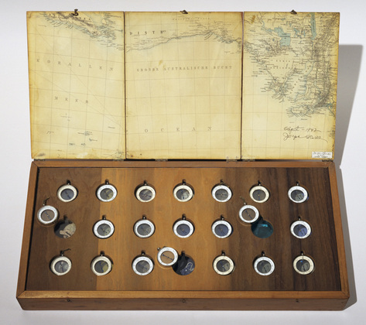
Cornell’s “Roses des Vents” (1942-1953)
Took him 11-years to complete!
It’s a wooden box with 21 compasses that all point in different directions!
They are set in a wood tray that rests on top of plexi glass.
Underneath the tray are 17 small compartments that show pictures and maps of far away places and remote coastlines.
Did he love to travel?
Cornell never left New York. He rarely left his house in Queens except to venture into Manhattan to find his beloved objects.
Why did he name it “Winds of Roses”?
Pink beaches?
Because maps have a “compass rose”?
We can only guess.

Slide 6
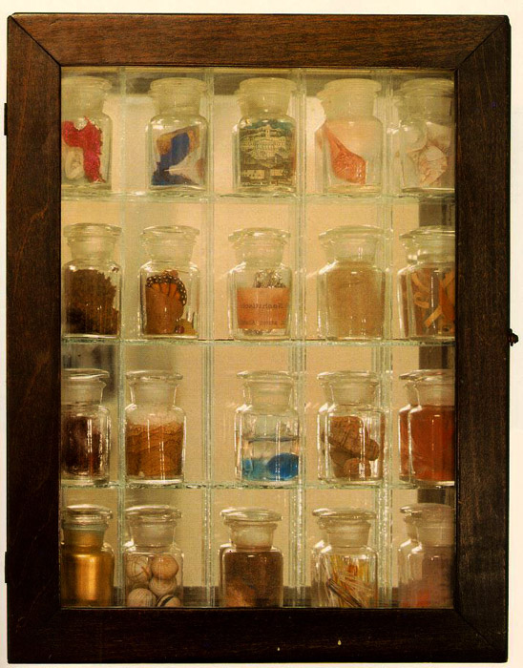
He loved to collect objects and put them in a glass bottle and carefully place them side-by-side.
* * * * *
1st row: Feather, printed post card, sea shell, sulfur crystals
2nd row: plant, butterfly wing, tin foil, fiber, wood shavings.
3rd row: copper wire, piece of magazine, water + blue marble, pit + rocks, feather+ shell.
4th row: gold paint, cork balls, colored sand, glass swizzle sticks, feather + shell.
Where do you think
he found these objects ?
Untitled (Pharmacy) 1943

Slide 7
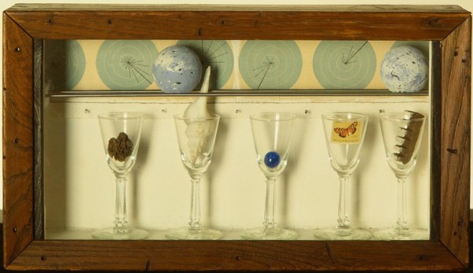
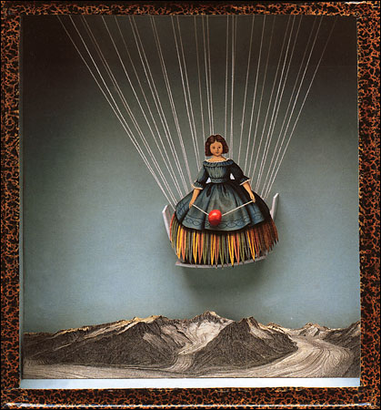
Cassiopeia 1 (1960)
SHADOW BOXES:
Many times he created them
based on subjects or things
that he liked: Astronomy,
Birds, Ballet, Film, other Artists,
Travels, Famous Actresses from Hollywood, Opera, Poetry and Literature.
COLLAGE: Later in his life he would cut, paste and re-combine images to create ideas, memories and dreams. He wanted to renew and transform materials, offer new experiences and ideas.

Slide 8
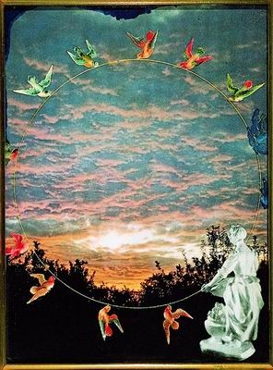
He used surprising and unusual combinations of materials and designs to show an idea or memory.
Joseph Cornell once said: “Everything can be used, but of course one doesn’t know it at the time. How does one know what a certain object will tell another.”
The Sixth Dawn
Cornell’s Collections Included:
books
seashells
marbles
wall paper scraps
sky charts
prints
toys
photographs
souvenirs
postcards
drawings
objects
memorabilia
metal springs
mirrors
feathers
music boxes
broken glassware
old advertising
and… BUTTERFLIES !

Slide 9
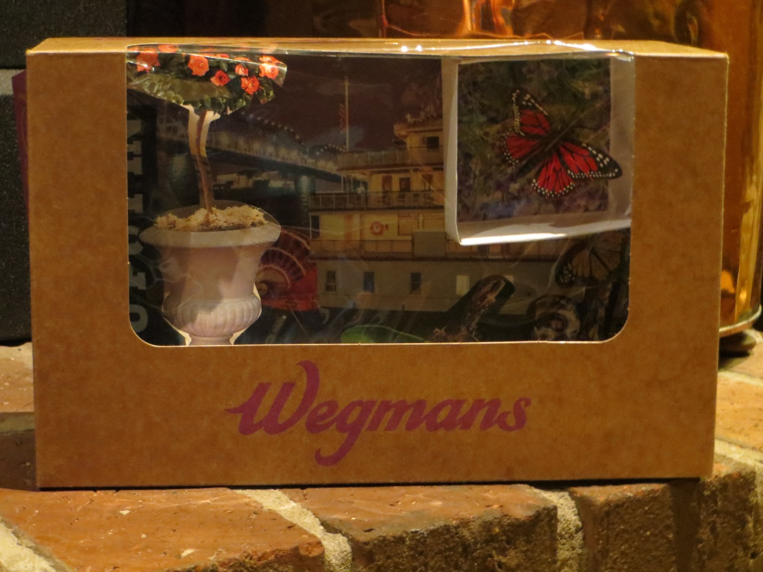
Collage like Cornell
Art Ambassador :
You will create art from a Wegmans bakery box.
You will be given a butterfly souvenir and this art box will be the visual story of the life of your butterfly.
You will glue pictures and objects that you collect today to decorate the inside of your Butterfly Box.

Slide 10
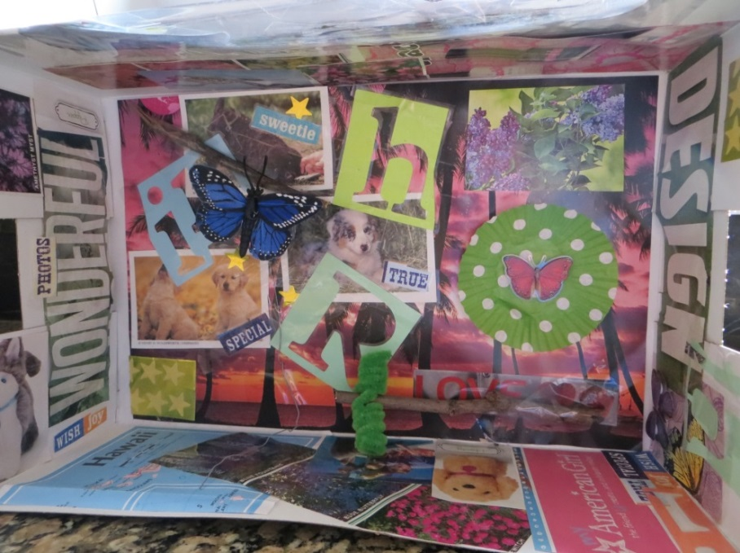
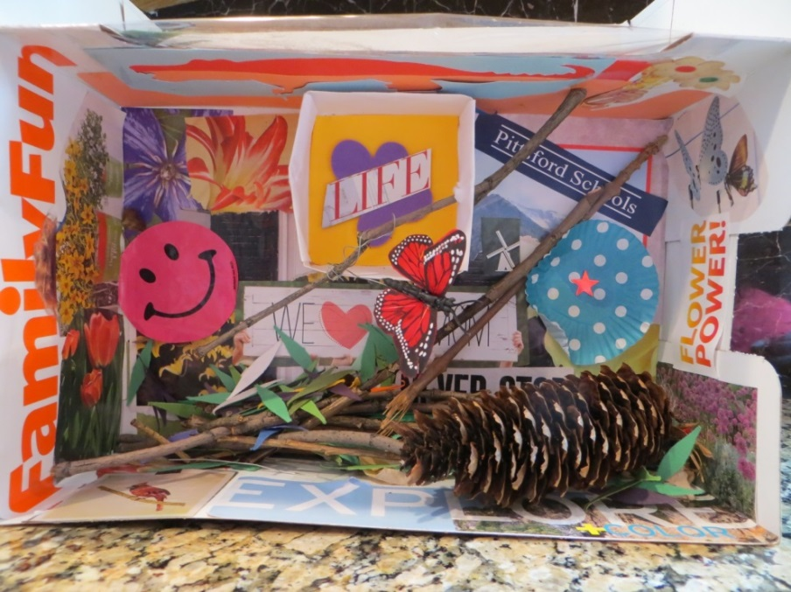
STEP 1:
15-20 MINUTES
Glue magazine clipppings to the INSIDE
of your Butterfly Box !
Be sure to put pictures on the
(4) inside walls of your box too!

Slide 11
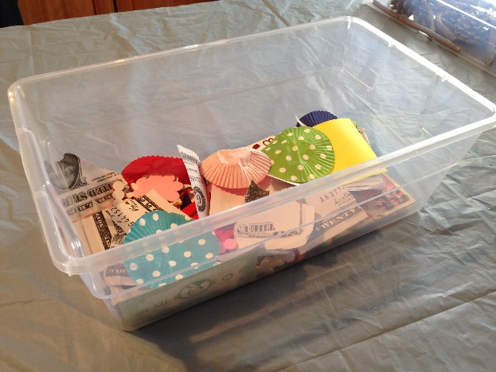
STEP 2:
8-10 MINUTES
“FOUND OBJECTS” also known as JUNK!
stickers
wrappers
paper
tickets
cards
junk !
bin
Glue or stick these found items to the INSIDE of your Butterfly Box.
Combine items and come up with new art pieces to add to the inside of your box.

Slide 12
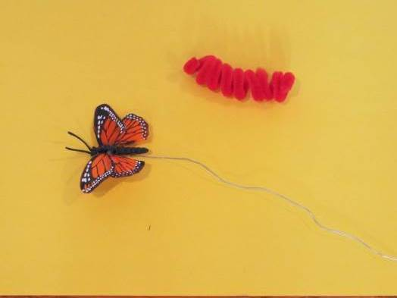
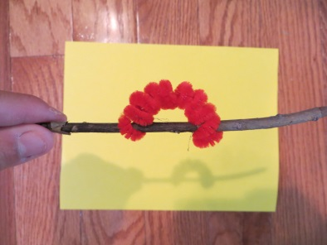
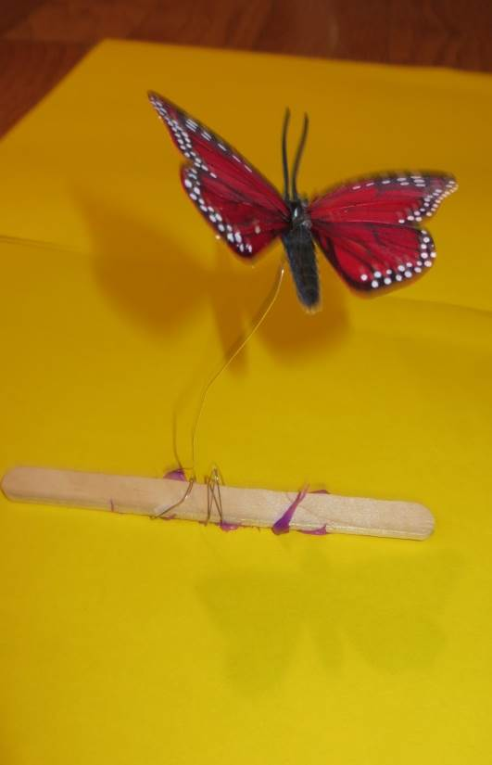
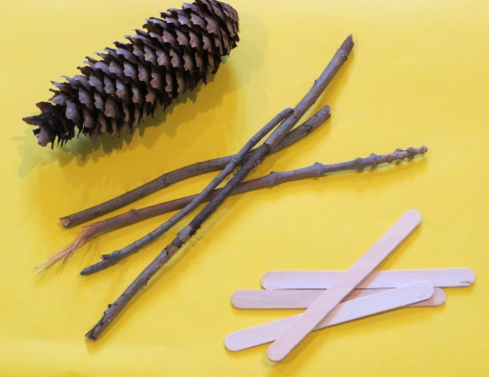
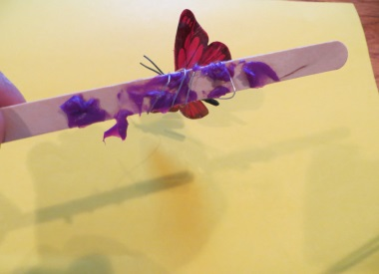
Hook your caterpillar onto your stick so he/she feels at home!
Cornell
SOUVENIRS
CATERPILLAR
BUTTERFLY
Pinecone
Wooden Stick
Popsicle stick
Wrap your butterfly
around the popsicle stick
* * *
Now add
CHUNKS of GLUE
( bottom of popsicle )
so your butterfly looks like it’s
flying inside
your box!
STEP 3:
10 MINUTES

Slide 13
Pharmacy
Sold at Auction in 2008
$3.8 MILLION
Lauren Bacall
Penny Arcade
Sold at Auction in 2014
$4.6 MILLION

Slide 14
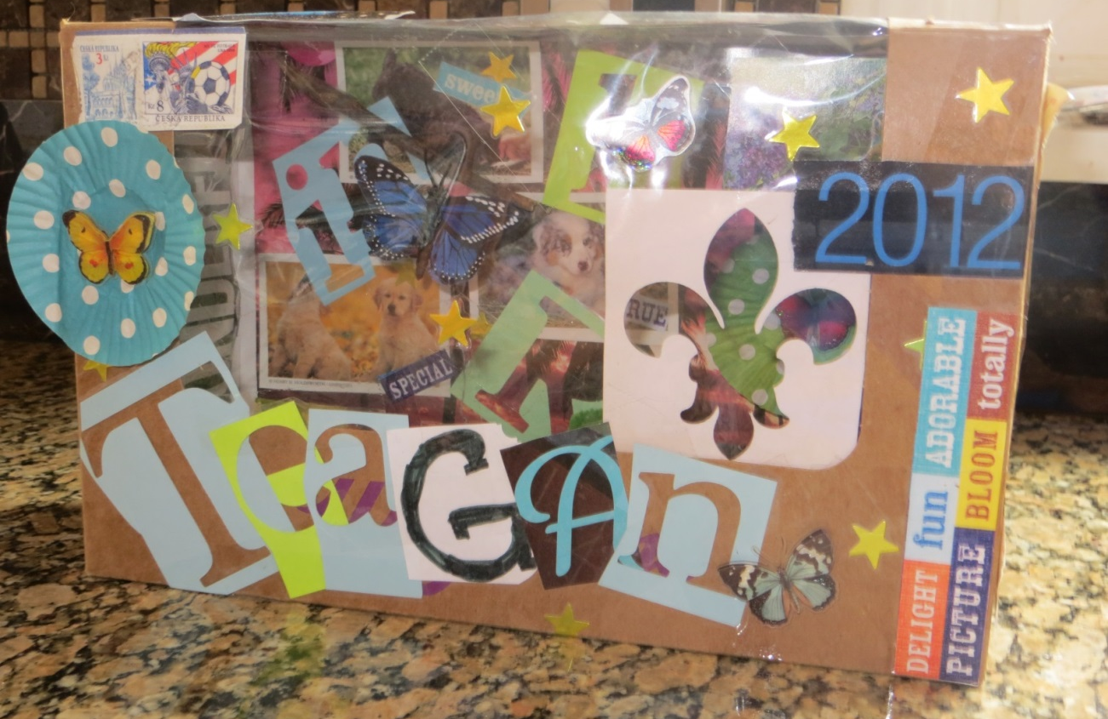
You can continue to add to the inside and outside of your Butterfly Box when you get home!

