Slide 1
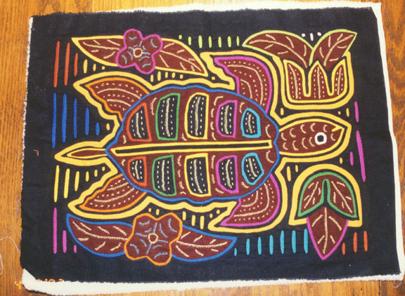
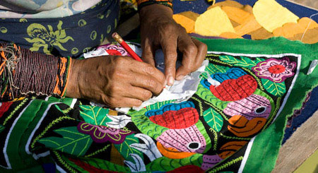
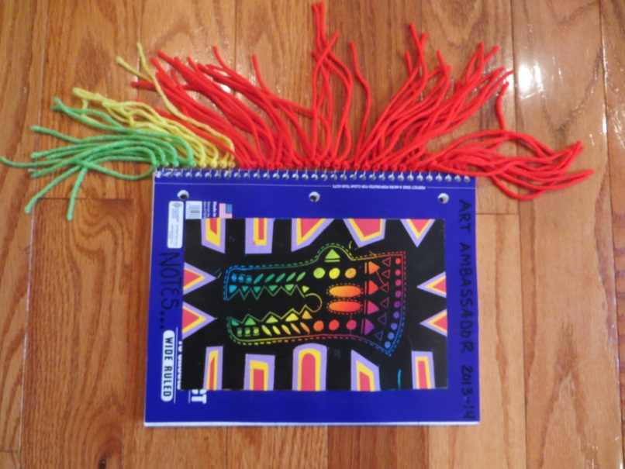
5th grade Art Ambassador:
Pittsford PTSA
“Magnifica Molas”
The Kuna Indians of Panama
By Teri Allart
Most Important Information
Supply Photo + List
Prep with pics
Training
Time Line
AA Lead Person Project Duties
“How To” photos of project
Volunteer Duties
Ties into 5th grade’s SOUTH/CENTRAL America unit.
Students create a modern “Mola” by adding scratch off paper along with Panama inspired stencils to a notebook. Stencils are traced onto scratch off paper and students use a “REVERSE APPLIQUE” technique that the Kuna Indians use to decorate around the stencil. Students love adding the yarn to the metal spirals to give it an authentic textile look.
We have real Molas in grade’s AA bin to show the students.
BUY (1-subject) WIDE RULED NOTEBOOKS at Walmart $ .17 each at BACK TO SCHOOL SALES. Don’t wait or they will cost $1.18+ each! Some Walmart Managers will honor the
$ .17 if you ask and let them know it’s for students.

Slide 2
PLEASE READ
District Art Ambassador (AA), Pittsford PTSA
PLEASE READ
These PowerPoint presentations for “Prep” and “Introduction” were written and designed by Teri Allart. A parent from Mendon Center Elementary who became Chair at MCE and was asked to become District Art Ambassador to bring her projects to the other Elementary schools of Pittsford.
As you read through, please check with your PTSA Chairperson to see how your school does things especially as it relates to Recruiting & Training.
Recruiting for Parent Volunteers (possible options): You will need to figure this out…
Sign up sheets. Typically done at the beginning of the year, listing email addresses. PTSA Chairperson for your school hopefully has.
“Volunteer Coordinator” for your school. Might handle all the recruiting for you.
Might designate someone on your team to handle all matters with seeking Volunteers.
Weekly PTSA e-mailer: can put a shout out to parents about seeking Volunteers.
School Web Editor and/or Webmaster might be able to add in the school’s e-mailer that AA is looking for Parent Volunteers. Hopefully, might be able to add a live link to allow parents to easily click to become a Volunteer.
Email Room Parents and request volunteers for the project.
Training:
Go to: Pittsford PTSA website / select your school / ART AMBASSADOR / click the grade and at the bottom will be the following:
(2) PowerPoints: (1) “Prep” for AA Chair/Lead AA and (1) is the “Introduction” (students see this PowerPoint in classroom). Backups of these are located on Google Drive or hard drive of the AA Chair. Need to download and be familiar with these in order to prepare for the project.
VIDEO: created by Amy Klinsky and Teri Allart showing prep for the project and a demonstration of the project.
The best way is to train Parent Volunteers is about 1-week before the actual projects.
The “Prep” PowerPoint mentioned above is printed out and inside the “Master” Art Ambassador book.
Send last few pages of the “Prep” PowerPoint to all Parent Volunteers, that are labeled “Volunteer Duties”
Tech:
Each school has different tech, so be sure to figure out how you are going to show the “Introduction” PowerPoint to the class.
Smartboard with Elmo OR Portable Projection both need a PC. If in the regular classroom usually we use the teacher’s PC, they will need to be able to access Pittsford PTSA website. Anything outside of that will need your laptop or you might be able to borrow one from school.
Download the (2) PP’s or get access to your Art Ambassador’s Google Drive. Need to have the “Prep” + “Introduction” PowerPoint (student’s see).
ALWAYS check Tech way before the project. Might need a special cable, tech changes all the time. Always check your tech!
You might need an ELECTRICAL CORD so you can move Tech around the room. Can ask Custodial Manager for one.
Room Layouts: Any and all layouts shown are suggestions only.
Room Usage Form:
When doing projects outside of the Teacher’s classroom, check to be sure of the room’s availability with the Main Office first. If ok’d, complete “Room Usage Form” (i.e., Cafeteria, Staff Cafeteria, Training Rm, etc.) and list all dates & times of use. You will also put any needed items; tables, portable tech, electrical cord, etc. for the Custodial department.
The guidelines of this project are written for use by the Chair Art Ambassador and/or Lead AA. Always check to see what your school has done in the past and follow, especially as it relates to the above items. As times changes and with new PTSA people, details of the above will most likely change too.
Presently, the District Art Ambassador is Teri Allart and the email to request PowerPoints is ptsa.artambassador@gmail.com. Other Pittsford Elementary AA’s are: mceartambassador@gmail.com , prartambassador@gmail.com , aceartambassador@gmail.com , treartambassador@gmail.com
2/2016

Slide 3
5th Grade AA: Molas/Kuna Indians
Most Important:
Scheduling:
This project can typically be done in the Teacher’s classroom.
Classes can be done back to back, with at least a 20-minute window in between for set-up.
OCTOBER: Contact Lead Teacher to schedule for DECEMBER.
This project can be tied into their South/Central America unit, so that might effect the month it’s scheduled.
If doing projects outside of Teacher’s classroom, the Main Office must first ok the dates, then let the Custodial Mgr and/or Cafeteria Mgr. know dates of the project & times
Logistics:
BE FAMILIAR with PREP PowerPoint and INTRODUCTION PowerPoint (students see in classroom) AND watch VIDEO to see prep and demonstration of the actual project. Find all by going to: Pittsford PTSA website / SCHOOL (select your school) / click on Art Ambassador / (select the grade).
Works best with (3-4) volunteers for EACH class.
BRING SAMPLE of PROJECT to all classes.
Students will make a paper Mola using “Reverse Technique” and scratch off paper in the style of the Kuna Indians of Panama.
BUY NOTEBOOKS ASAP: Need (1) Subject, WIDE RULED, SPIRAL NOTEBOOK from Walmart ( $ .17 during Back to School): ONE PER STUDENT
FIGURE OUT YOUR TECH…. teacher’s PC or yours/borrow one, do you need a screen, cables, is it working and/or compatible?
For about every (5) students they’ll share an ART BOX full of the supplies for this project, including stencils
As part of the student’s INTRODUCTION of Kuna Indians of Panama, please show the Authentic Mola that’s in the grade’s AA bin...
Due to the timing on this project, students will only have enough time to glue (2) colors to their Mola.
Need to download the MOLA/Kuna Indians “Introduction” PowerPoint for students AND “Prep” for AA Chair/Lead AA (printed off in the Master AA Book for your school).
Supplies & Prep:
BUY SUPPLIES NOW. NOTEBOOKS are cheaper at “Back to School” Sales!
PREP NOW. Using a cutting board in this project makes prep a lot faster. Be sure to look for any supplies from last year in the grade’s AA bin.
Organize all supplies by bundling for each class.
To complete this project students will need: GLUE STICK and SCISSORS

Slide 4
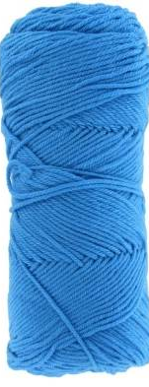
5th Grade AA: Molas/Kuna Indians
SUPPLY PHOTO
Glue sticks
NOTEBOOKS: Spiral, One Subject, WIDE ruled BUY @ BACK to SCHOOL for 17 cents!
Art Boxes (6)
(holds supplies)
(6-7) YARNS
Panama
Stencils
FIND A BOOK
about 10-12” tall
Multi-Color
Scratch Off Paper
Scratch Off
sticks
Authentic Molas
(Primary Colors)
STOCK PAPER

Slide 5
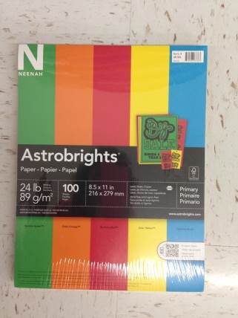
5th Grade AA: Molas/Kuna Indians
SUPPLY LIST
WALMART:
(ONE PER STUDENT) 1-Subject, WIDE RULED, spiral NOTEBOOK: only buy this one !!!
VERY IMPORTANT: PURCHASE AT BEGINNING of School Year to get “Back to School” pricing at $ .17 cents each. Once the sale is over, they go up to $1.18 each and the budget won’t be able to afford it. VIP: Try and get ahead, so you’re always buying notebooks for next year…. BECAUSE… if ever the notebooks aren’t priced at $ .17 each, you’ve got 1-year to come up with an alternative.
(6-7) Rolls of yarn in different colors;
RED, ORANGE, YELLOW, GREEN, BLUE, PURPLE, BLACK (colors the Kuna’s used).
(ONE PACKAGE PER CLASS) “ASTROBRIGHTS”; 100 pcs of cardstock paper (see pic to the right):
Buy in the PRIMARY COLORS, sometimes they’ll have 5 or 6 colors per package.
Very bold red – yellow, etc., see package photo to make sure you purchase the correct one.
These will get cut in half.
DICK BLICK:
Purchase at beginning of School Year (so it can ship in time)
(2-3) Packages of rainbow SCRATCH OFF PAPER
ITEM# 13501-2085 --- CLR SCRATCH PAPER --- Multi 8.5” x 11” --- 50/PK
For this project, the paper is cut in half with EACH student getting (1) 4¼ x 5½ sheet
ITEMS TO FIND in the Grade’s AA storage bin:
(25) wood scratch off sticks; (1) for each student
(6) ART BOXES
(8) Sets of Panama Animals and Kuna inspired Stencils
Left over colored paper and yarn
To complete the project, students will need: glue stick and scissor

Slide 6
5th Grade AA: Molas/Kuna Indians
PROJECT TIME-LINE:
SEPTEMBER:
BUY NOTEBOOKS from WALMART so you get “BACK to SCHOOL” pricing of $ .17 vs $1.50!
BUY Scratch Off Paper from Dick Blick, they can run low.
OCTOBER:
Contact 5th grade “LEAD Teacher” and ask to schedule their Art Ambassador (early/middle December).
Project is typically done in the classroom and can be scheduled back to back with a 20-minute window for set-up
Works best with 3-4 Volunteers
Once they respond with their dates & times, DETERMINE training dates for EACH PROJECT (usually week before)
Complete Room Reservation form for TRAINING that will be done within the school.
Let other team members know the dates and start coordinating.
BUY NEEDED SUPPLIES NOW and PLAN FOR PREP ASAP
MONTH BEFORE PROJECT:
Post for volunteers; works best with (4-5) Volunteers; school express or Volunteer Coordinator and use an eform if an option. Let them also know dates & times of projects AND TRAINING DATE too.
If an option, contact PTSA Web Leader and request an eform be activated on the PTSA AA page for volunteers. Let them know the dates & times of projects AND TRAINING DATE TOO.
If an option, email Room Parents and request they send email to parents requesting volunteers and include the eform link.
All prep should be done by this point.
Create Art Boxes and BUNDLE/ORGANIZE all supplies by class.
Figure out your TECH, check for compatibility, cables, screens, etc. and assure it’s all going to work properly.
Make arrangements to TRAIN Parent Volunteers
Determine who will be the Lead AA Person to do the Introduction PowerPoint.
Train Lead AA People: demonstrate project and mention main pointers and/or problems and tell them where supplies are
1-2 WEEKS BEFORE PROJECT:
Train Volunteers: demonstrate project, mention main pointers and/or problems and show them where supplies are.
Send email to volunteers to “Thank them for Volunteering”, INVITE THEM TO TRAINING, and include the following:
The times & dates of ALL the grade’s AA projects + times & dates of TRAINING.
If necessary, ask Volunteers to consider covering for other classes if low on volunteers
Attach last few pages of the “Prep” PowerPoint that’s labeled “Volunteer Duties”.
LINK for the video which shows how the project is done.
Email the Custodian Manager (and/or Cafeteria Manager) if you’re near their areas or need anything for the project.
KNOW and TEST YOUR TECH
CHECK TO MAKE SURE YOU HAVE ALL SUPPLIES and they are bundled per class.
Email teachers and confirm project (dates & time). NEVER forget to do this!
To complete project students will need: a GLUE STICK and Black Sharpie Marker.

Slide 7
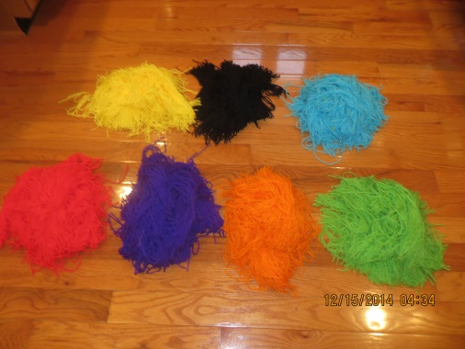
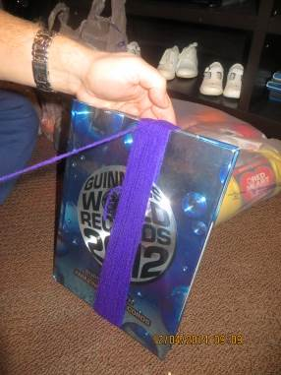
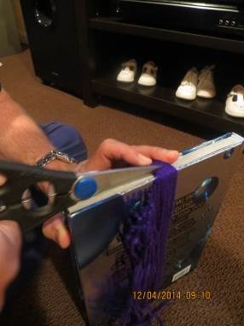
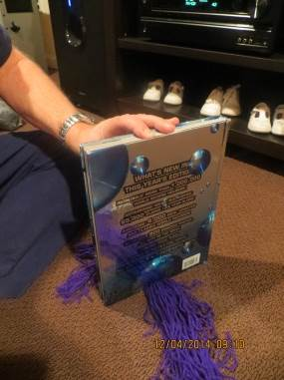
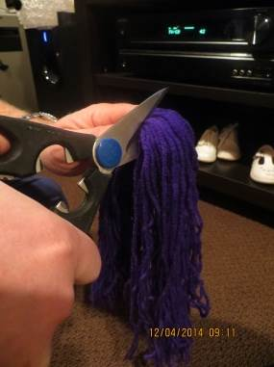
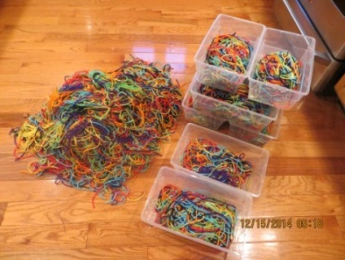
5th Grade AA: Molas/Kuna Indians
PREP: Page 1 of 3
YARN PREP:
Find a book that’s about 10”-12” TALL
WRAP the yarn around the book (maybe about half of it)
Cut it at the top, HOLD tightly. Then cut it again at the half way point. Now you have 10’-12” length yarn.
Do this several times until all the yarn is gone.
REPEAT this for each color of yarn.
NOW…. combine all the colors together and then put handfuls into each one of the (8) art boxes.

Slide 8
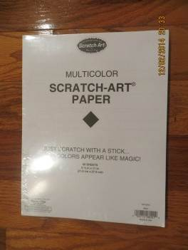
5th Grade AA: Molas/Kuna Indians
PREP: Page 2 of 3
SCRATCH OFF PAPER:
Cut all of the 8 ½ x 11 black scratch off paper in half
Each student gets (1)
Wash hands before handling; the oils from your hands will mark it up
COLORED PAPER:
Cut all (5) packages of colored card stock paper in half
Sometimes the packages will give you (4) or (5) colors.
I usually put ONLY (4) COLOR CHOICES into the art boxes for each class. This way each class will have it’s own unique color set and they will look different.

Slide 9
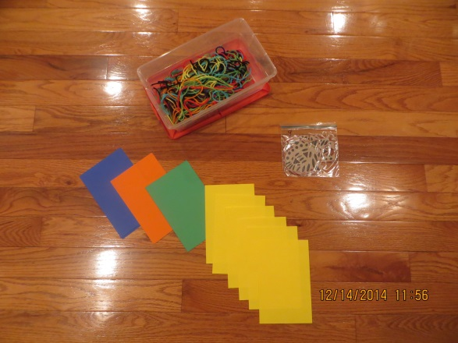
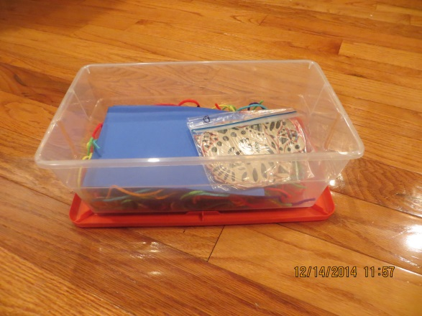
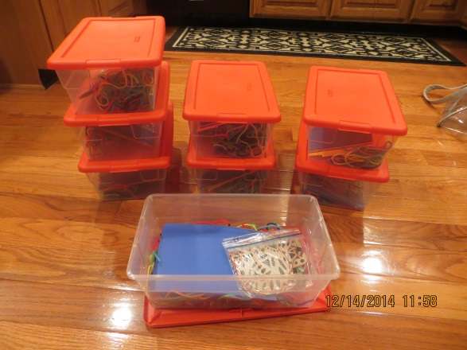
5th Grade AA: Molas/Kuna Indians
PREP: Page 3 of 3
CREATE (6) ART BOXES:
Have to re-set BEFORE each class
(put on very bottom of art box) Place HUGE handful of the (7) yarns that are all mixed together into EACH of the Art boxes; 15-pcs per student approx.
FOUR color choices of paper: 6-pieces of each color.
(6-8) pieces of black SCRATCH OFF PAPER
(1) set of the Panama Stencils (9 designs) in a baggie
(6-8) wooden scratch off sticks
Each group of 5-students in the classroom will get an Art box, if a long table… give them (2) Art boxes.

Slide 10
Items to be AWARE of for VOLUNTEERS (and you)
Students will first sit and watch the Mola/Kuna Indians Introduction.
Students should open up their notebooks (so you see two pages) and use this as their working surface… NOT THEIR DESKS, they’ll get glue all over them!
DO A DEMONSTRATION of how the project is done
THIS PROJECT IS NOT DIFFICULT…. BUT…. the students will need some ideas and encouragement so that other students in the room might try their decorating ideas. So be sure to mention out loud AND show off students decorating to the other students.
ONLY GLUE the top of the colored paper, NEVER glue the back of t0he scratch off paper! It will RIP!
Even when doing the second colored paper, STILL GLUE THE TOP of the colored paper, line it up to colored paper and stick down. If we tried to glue the back side of the MOLA it would RIP because of all the cuts we’ve made into the frame.
Step 1: STENCIL
must be CENTERED onto the scratch off paper VERTICALLY, then traced onto the scratch which is also vertical, using scratch off stick.
Students should ONLY decorate the INSIDE. They will be cutting away a lot of the material around it.
Suggest students look at the stencil for ideas... NOT TO COPY IT….. They should scratch off LARGE long ovals, circles, triangles etc. Feel free to scratch away the insides of these shapes for more color. Add dashes around the stencil to make it look like stitching . Feel free to add more designs – make it unique
Step 2 & 3: CUTTING & GLUING
MAKE SURE STUDENTS DON’T CUT OUT THE STENCIL!! They should only be cutting into the frame with squares, triangles to get the REVERSE APPLIQUE LOOK.
Uses a technique called “REVERSE APPLIQUE”…. Students are building their Mola from the backside. They will do this TWICE.
NEVER NEVER GLUE back of scratch off paper! Students will glue the ENTIRE FRONT of the colored paper. IT WILL RIP!!
Step 4: Gluing Mola Art to Notebook
Tell students to glue back of their MOLA ART AND the ENTIRE TOP of their NOTEBOOK so that it really sticks.
FLIP back of notebook cardboard over onto FRONT of notebook (so Mola is covered) and have students rub NOW to make sure the Mola sticks OR…. Students will be RUBBING the Mola art directly and it will scratch up!
Step 5: “YARN TRICK”
TELL STUDENTS to hang the spirals of the notebook off the edge of their desk, makes it easier to thread the yarn through and they aren’t unraveling the yarn by hitting the desk top.
Students should tie TWO KNOTS when securing the yarn so that it won’t slip off.
TRAINING

Slide 11
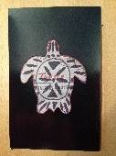
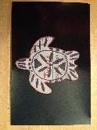
5th Grade AA: Molas/Kuna Indians
Project Duties:
AA Lead Person ONLY
1 of 2
Be sure to bring SAMPLE of PROJECT to each class.
Project is typically done in the class rooms; 1-hour + 20 minute set-up
Project runs best with 3-4 Volunteers PER class
Arrive 30-minute prior to the scheduled time to bring in materials and help with SET-UP
SET-UP:
Students will need (either supply or if at their desks, ask them to get out): glue sticks, scissors, and colored pencils
HAND OUT cafeteria TRAY (helpful if you have them, protects desk from glue)
ONE Notebook per student
MATERIALS in Art Boxes:
(6) pieces of paper in each color
1-SET of Panama Stencils; they each have meanings: detailed in Introduction PP
(6-8)scratch off sticks
(6-8) pieces of Black Scratch Off Paper
INTRODUCTION: Kuna Indian’s PowerPoint, “Magnifica Molas” (10-minutes)
PROJECT:
SHOW STUDENTS SAMPLE OF PROJECT
Trace & Decorate Panama Stencil (15-20 minutes)
Tell students to PICK ONE stencil (9 to choose from, discuss the meaning from overhead)
Take one BLACK scratch off sheet and tell them to put in front of them the LONG WAY (vertical)
Tell students to put their chosen stencil CENTERED on the scratch off paper, the “LONG WAY” again (VIP!)
DO A QUICK CHECK to make sure stencils are right, BEFORE TELLING THEM TO DECORATE!!
Tell students to look at suggested ideas on the stencil, BUT come up with their own designs!
Suggest they decorate with ovals, circles, squares, triangles etc. to the INSIDE ONLY of their stencil. Important: we will be cutting into frame of paper.
Walk around while they are decorating and hold up STUDENTS designs, show them off to their class mates!! Point out what you like! This will HELP each others come up with ideas to decorate their stencil.
Suggest they thicken up tracing line around stencil, add dashes for stitches, do squares, ovals, dots, squiggles, triangles, dashes, thicken up the lines, etc
STEP 1:
CORRECT
WRONG

Slide 12
5th Grade AA: Molas/Kuna Indians
Project Duties:
AA Lead Person ONLY
2 of 2
STEP 2:
Cut into FRAME of stencil & glue: 1st Reverse Applique (5-8 minutes)
Tell students to OPEN UP their NOTEBOOK to 2-white pages and use it as their working surface, not their desk!
Show students how to cut out LARGE (wide) squares, triangles, shapes all around the stencil.
TELL THEM NOT TO CUT OUT THE STENCIL!! Only cutting shapes into the frame, all around stencil
Pick ONE colored sheet of paper and put in front of them the LONG WAY (vertical)
Glue the ENTIRE FRONT of colored paper
Line up a corner of the scratch off paper to the colored paper, and gently tap it down
Now flip their Art Mola upside down onto their notebook paper and rub the back to get bubbles out and make it stick.
GENTLY pull it up, it will stick to notebook paper a little bit.
Inform students they have just done a “Reverse Applique” technique --- adding color from behind.
STEP 3:
Cut into FRAME again & glue: 2nd Reverse Applique (5-8 minutes)
Remind students to use their opened notebook as a working surface, not their desks.
Show students how to cut into these same shapes again, but leaving a little of the first color as an edge
Tell students to now CUT the same shapes out again, same opening, but make a little smaller
Pick a different colored sheet of paper
Glue the ENTIRE FRONT of colored paper AGAIN
Place corner of Mola Art to the colored paper’s corner, line it up, and gently tap it down
Put it UPSIDE DOWN AGAIN on their notebook and rub the back again for bubbles and to make it stick.
Gently pull it up again.
DO ONE MINUTE MAINTENANCE: If any pieces of paper are sticking up, add some glue and tap it down.
STEP 4:
Glue MOLA ART to NOTEBOOK (2-3 minutes)
Glue entire front of the notebook AND the back of the Mola ART, and stick the two together.
Show students the “TRICK”…. FLIP the very back cardboard of the notebook forward… so it’s covering your Mola Art and now RUB to get it to stick and then flip it back into place. This way you don’t scratch up your art.
STEP 5:
Adding YARN to notebook (5-7 minutes or time remaining)
Move the notebook so that the spiral part hangs off the edge of the desk, thread the yarn through each spiral, makes it easier to thread the yarn.
Make ends of your yarn even (like you’re tying your shoe) and do TWO knots so it doesn’t slip.
CONCLUSION: Ask students the following…
Tell me something you learned today about the Kuna Indians?
Tell me something you learned today about Molas?
Tell me something else you learned from Art Ambassador? (Reverse Applique?)
CLEAN UP and RE-SET
10-15 minutes
10 minutes

Slide 13
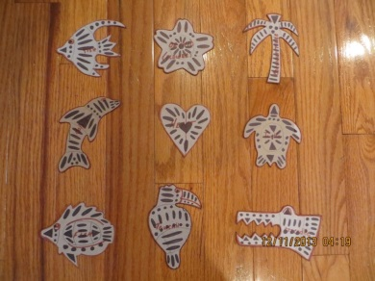
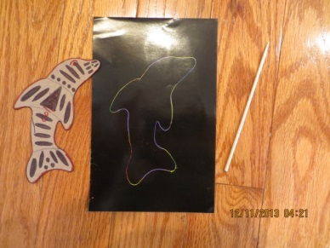
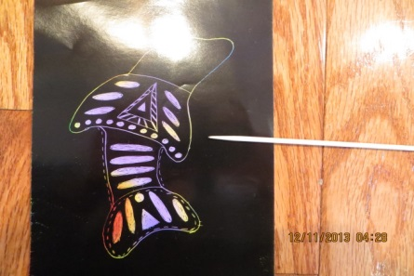
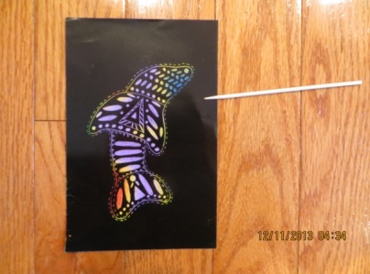
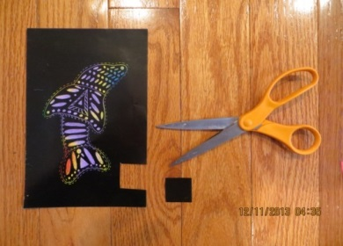
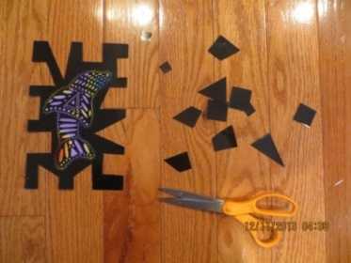
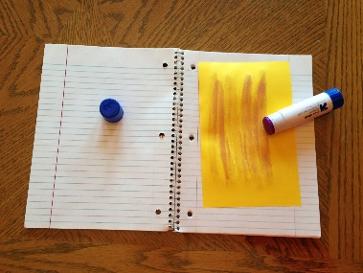
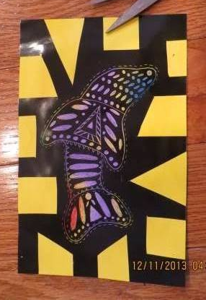
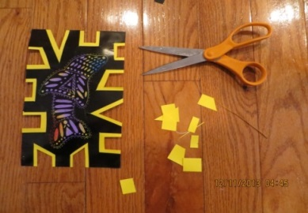
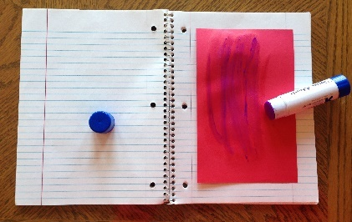
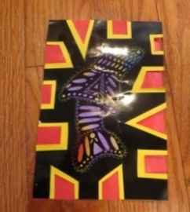
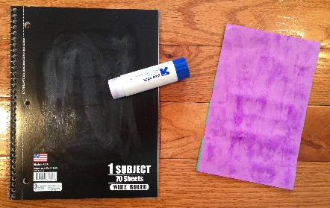
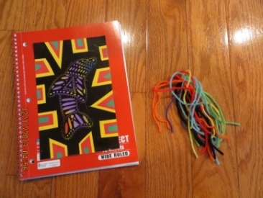
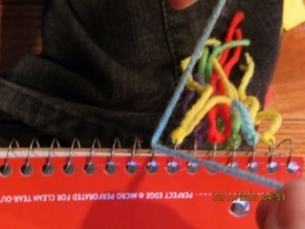
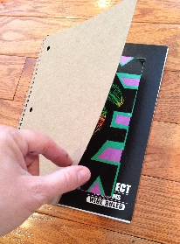
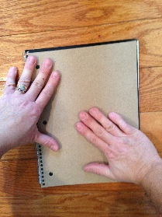
5th Grade AA: Molas/Kuna Indians
“How To” of project
Step 1
Step 2
glue
this!
Step 3
glue
this!
TRICK: hang notebook off desk to thread the yarn thru spirals
TRICK: use back flap
to press it down
Step 4
glue
Step 5
glue

Slide 14
5th Grade AA: Molas/Kuna Indians
Volunteer Duties:
1 of 2
Project is typically done in the class room
STUDENTS will need: glue stick, scissors, and colored pencils to complete the project
ARRIVE 20-MINUTES prior to the scheduled time of the project to help with set-up.
Make sure students open up their notebooks to 2-pages and uses them as their working surface, not their desks.
SET-UP:
(1-2) Volunteers:
Should either tell students to get out: GLUE STICK, SCISSORS, and COLORED PENCILS or check with AA Lead and hand out.
(1) Volunteers:
(IF AVAILABLE) Place one cafeteria tray in front of each student.
Put ONE NOTEBOOK in front of each student; DO NOT give students a color choice.
(1-2) Volunteers:
RE-FILL Art Boxes with bundled supplies if not done.
Inside each Art Box should be the following materials:
(1) Panama Stencil SET with 9-stencils
(6) pieces of Black scratch off paper
(6-8) scratch off sticks
FOUR color choices of paper: (6) pieces of EACH
BIG HANDFUL of yarn (at the bottom)
Place at least (1) Art Box for every 5-students. If they are sitting in a long row, place an extra Art Box
INTRODUCTION:
Mola/Kuna Indian PowerPoint (10-minutes)
(1-2 VOLUNTEERS) After Introduction… Show students samples of the Mola Project

Slide 15
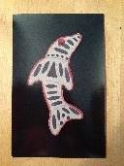
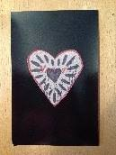
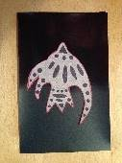
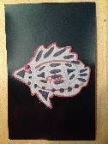
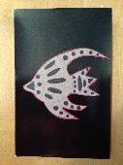
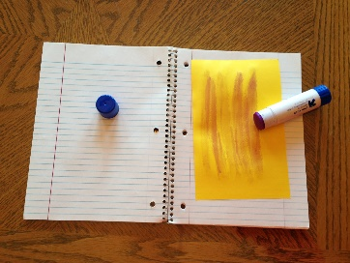
5th Grade AA: Molas/Kuna Indians
Volunteer Duties:
2 of 2
CORRECT:
Step 1: Trace and Decorate Stencil
Very Important: Make sure each student is putting the stencil in the VERY CENTER of their BLACK scratch off paper.
Dolphins have to be slanted slightly
All stencils should be going the “LONG WAY” on the paper which is also placed VERTICAL (see pics to right)
CHECK QUICKLY before they start tracing their stencil!
If a scratch off stick isn’t working, please grab another for the student and throw the bad one away
ENCOURAGE their designs, pick out ones that are different and SHOW OFF to class and say they should try that too… SYNERGY!
Step 2: Cut into frame of stencil & Glue - Reverse Applique (first color choice)
Students should OPEN UP notebook to 2-white pgs and use as a working surface, not their desk!
Watch to make sure the student’s AREN’T cutting out the stencil. They should only be cutting squares and triangles into the FRAME AROUND their stencil
These shapes should be large, not small. PLEASE PICK UP THESE PIECES and throw away
AGAIN… watch to be sure they’re aren’t cutting our their stencil. There should be a frame left around the stencil
Student’s will pick ONE COLOR
BE SURE THEY apply glue to the ENTIRE TOP of the COLORED PAPER
Be sure student’s don’t try gluing the back of their Black scratch off paper (it will rip)
Step 3: Cut into Frame AGAIN + Glue - 2nd Reverse Applique (final color choice)
Again, remind students to use their opened notebook as a working surface – not their desk.
Watch that students cut into the same shapes around MOLA but a little smaller, so they can see the first color
Pick 2nd color choice and watch that they glue the TOP of the COLORED paper and not the back of their Art Mola
Line up a corner of the Art Mola to the same corner on the colored paper and gently tap it down
Flip over Art Mola and rub the back so it sticks and gently lift it off
Don’t want to rub across the scratch off it will ruin it.
ONE MINUTE MAINTENANCE: their paper layers won’t all be stuck down, suggest they add a little glue to the back and tap it down.
Step 4: Gluing Art Mola to Notebook’s cover
Students need to use a lot of glue to the backside of their Mola Art and the middle of their front cover of their notebook
There’s a “TRICK”…. FLIP the back cardboard of the notebook forward… so it covers Mola Art just glued, and now RUB to get it to stick and then flip it back into place. This way they don’t scratch up art.
Step 5: Yarn added to Notebook spiral (last 10-minutes)
“TRICK”… hang spiral of notebook off edge of their desk, thread the yarn through a spiral look and double knot the yarn.
Easier to thread and they won’t keep ruining their yarn
These are WRONG
glue
here!
CORRECT

