Slide 1
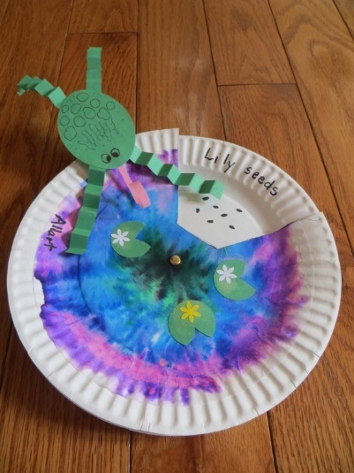
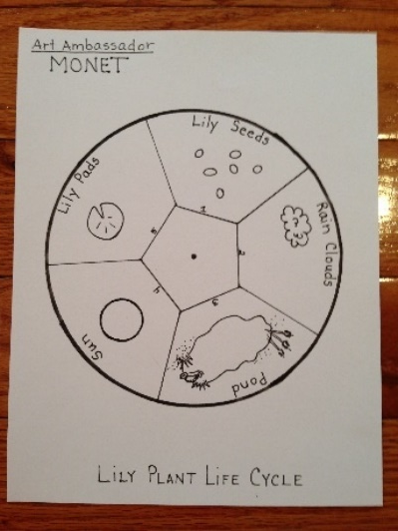
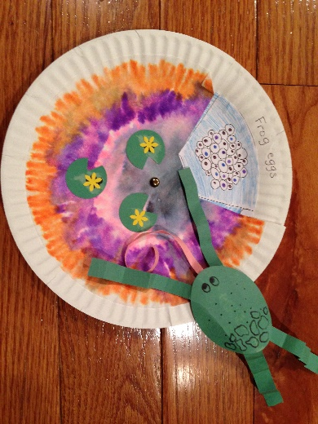
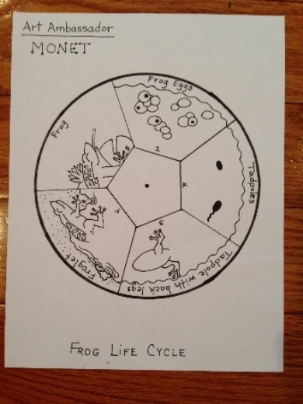
1st grade Art Ambassador
Pittsford PTSA
“ Mini Monet’s ”
By Teri Allart
Ties into 1st grade’s Life Cycle Unit of a Plant OR Frog.
Students will draw their “IMPRESSIONS” of either the Lily Plant or Frog Life Cycle, to create a spinning paper plate that will provide a watercolor home for their Monet Frog.
This Art Ambassador is a little differently arranged. We have the kids do (3) “drawing races” FIRST (coloring their coffee filters) then we do the Monet Introduction. This buys us the time we need so that volunteers in the EXTRA ROOM can prep the TOP plate and return it to the classroom.
Lily Plant or Frog Life Cycle

Slide 2
PLEASE READ
District Art Ambassador (AA), Pittsford PTSA
PLEASE READ
These PowerPoint presentations for “Prep” and “Introduction” were written and designed by Teri Allart. A parent from Mendon Center Elementary who became Chair at MCE and was asked to become District Art Ambassador to bring her projects to the other Elementary schools of Pittsford.
As you read through, please check with your PTSA Chairperson to see how your school does things especially as it relates to Recruiting & Training.
Recruiting for Parent Volunteers (possible options): You will need to figure this out…
Sign up sheets. Typically done at the beginning of the year, listing email addresses. PTSA Chairperson for your school hopefully has.
“Volunteer Coordinator” for your school. Might handle all the recruiting for you.
Might designate someone on your team to handle all matters with seeking Volunteers.
Weekly PTSA e-mailer: can put a shout out to parents about seeking Volunteers.
School Web Editor and/or Webmaster might be able to add in the school’s e-mailer that AA is looking for Parent Volunteers. Hopefully, might be able to add a live link to allow parents to easily click to become a Volunteer.
Email Room Parents and request volunteers for the project.
Training:
Go to: Pittsford PTSA website / select your school / ART AMBASSADOR / click the grade and at the bottom will be the following:
(2) PowerPoints: (1) “Prep” for AA Chair/Lead AA and (1) is the “Introduction” (students see this PowerPoint in classroom). Backups of these are located on Google Drive or hard drive of the AA Chair. Need to download and be familiar with these in order to prepare for the project.
VIDEO: created by Amy Klinsky and Teri Allart showing prep for the project and a demonstration of the project.
The best way is to train Parent Volunteers is about 1-week before the actual projects.
The “Prep” PowerPoint mentioned above is printed out and inside the “Master” Art Ambassador book.
Send last few pages of the “Prep” PowerPoint to all Parent Volunteers, that are labeled “Volunteer Duties”
Tech:
Each school has different tech, so be sure to figure out how you are going to show the “Introduction” PowerPoint to the class.
Smartboard with Elmo OR Portable Projection both need a PC. If in the regular classroom usually we use the teacher’s PC, they will need to be able to access Pittsford PTSA website. Anything outside of that will need your laptop or you might be able to borrow one from school.
Download the (2) PP’s or get access to your Art Ambassador’s Google Drive. Need to have the “Prep” + “Introduction” PowerPoint (student’s see).
ALWAYS check Tech way before the project. Might need a special cable, tech changes all the time. Always check your tech!
You might need an ELECTRICAL CORD so you can move Tech around the room. Can ask Custodial Manager for one.
Room Layouts: Any and all layouts shown are suggestions only.
Room Usage Form:
When doing projects outside of the Teacher’s classroom, check to be sure of the room’s availability with the Main Office first. If ok’d, complete “Room Usage Form” (i.e., Cafeteria, Staff Cafeteria, Training Rm, etc.) and list all dates & times of use. You will also put any needed items; tables, portable tech, electrical cord, etc. for the Custodial department.
The guidelines of this project are written for use by the Chair Art Ambassador and/or Lead AA. Always check to see what your school has done in the past and follow, especially as it relates to the above items. As times changes and with new PTSA people, details of the above will most likely change too.
Presently, the District Art Ambassador is Teri Allart and the email to request PowerPoints is ptsa.artambassador@gmail.com. Other Pittsford Elementary AA’s are: mceartambassador@gmail.com , prartambassador@gmail.com , aceartambassador@gmail.com , treartambassador@gmail.com
2/2016

Slide 3
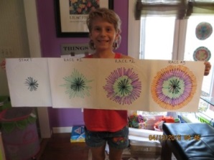
1st grade AA – Claude Monet, Mini Monet’s
Most Important:
Scheduling:
This project can be done within the Teacher’s classroom + AN EXTRA ROOM (to blow dry colored filters)
Classes can be scheduled back to back, with a 15-minute window needed for making up the trays for students
JANUARY: Contact Lead Teacher to schedule at a time when hopefully the students are doing their Frog or Plant Life Cycle.
If doing projects outside of Teacher’s classroom, Main Office, Custodial Mgr. and/or Cafeteria Mgr. need to know the dates of the project & times too.
Logistics:
Works best with (4-5) Volunteers PER CLASS
BRING SAMPLE of PROJECT to all classes
ALSO BRING the DRAWING RACE example (see pic to far right)
Need to create “Frog Kits”; 1 per student
Lead Teacher has to decide if they want to do the “Frog Life Cycle” or “Lily Plant Life Cycle” for their AA (both are on PDF files)
Once 1st grade decides which cycle they want, you need to get the PDF file to BRMS Print Shop, once it is returned to you, ask volunteers to cut the circle out. This prep should be done ASAP.
FYI: there is NOT enough time in the project for students to cut & glue the circular Life Cycle (Frog/Lily). Volunteers need to cut it out and glue to a plate as part of prep.
FIGURE OUR YOUR TECH…. screens, cables, laptop, Epson, school’s computer, etc. is it working and/or compatible?
Need to download & review: Monet’s “Introduction” PowerPoint AND “Prep” for AA Chair/Lead AA (printed in Master AA book)
Student’s will watch while the Lead AA Person does the Introduction of the Monet PowerPoint AFTER the 3-drawing races.
BE FAMILIAR with PREP PowerPoint and INTRODUCTION PowerPoint (students see in classroom) AND watch VIDEO to see prep and demonstration of the actual project. Find all by going to: Pittsford PTSA website / SCHOOL (select your school) / click on Art Ambassador / (select the grade).
Supplies & Prep:
BUY SUPPLIES ASAP. Don’t wait until you’re closer to the project. Buy the right BRAND and AMOUNT! Check grade’s AA bin for left over supplies
PREP ASAP and eventually organize all by bundling for each class.
To complete this project students will need: black sharpie marker (AA provides), colored markers (AA provides), black ink pen (AA provides), pencil, glue stick, and colored pencils.

Slide 4
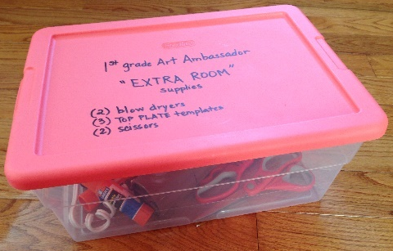
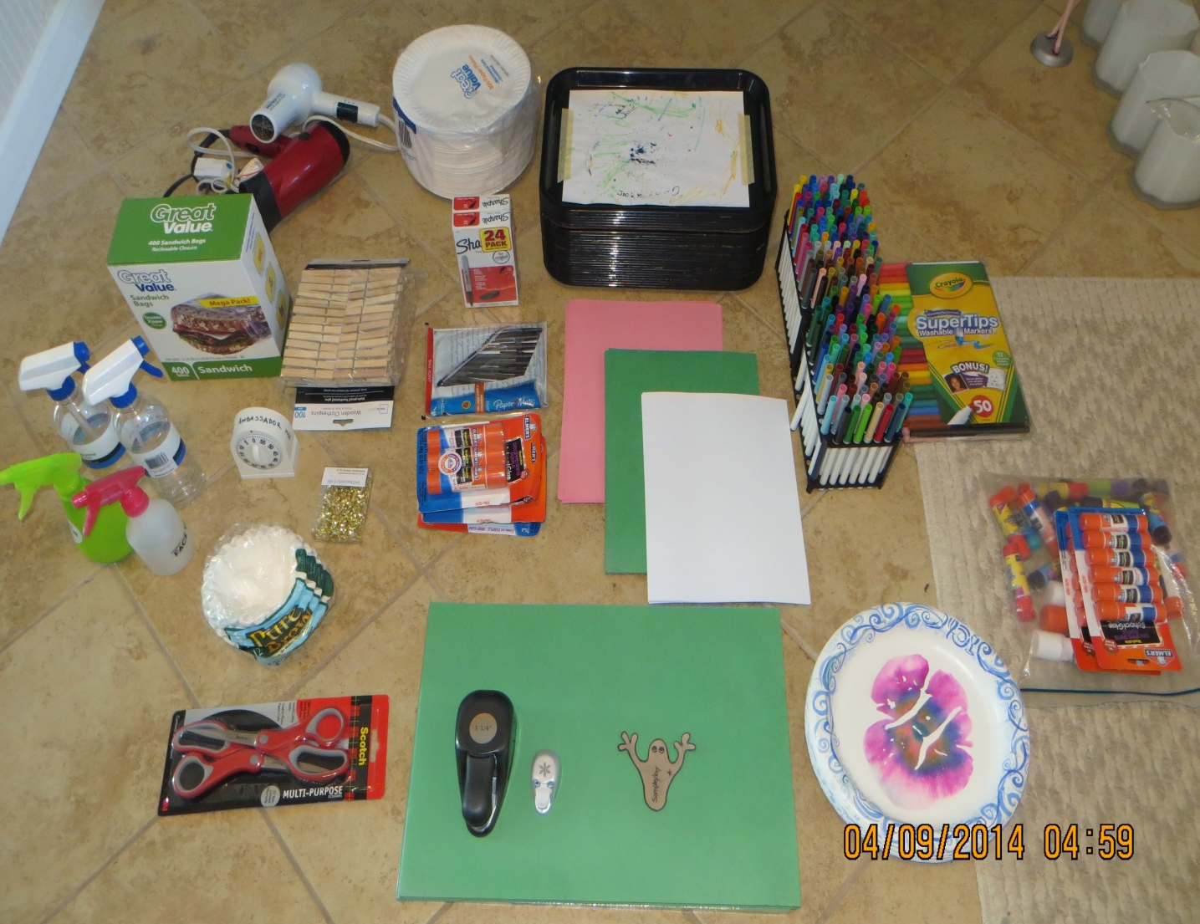
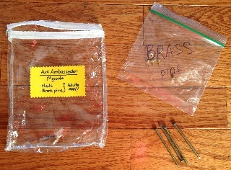
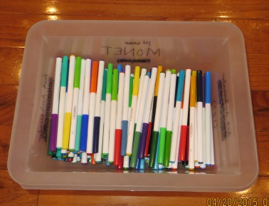
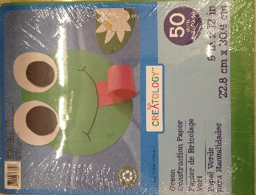
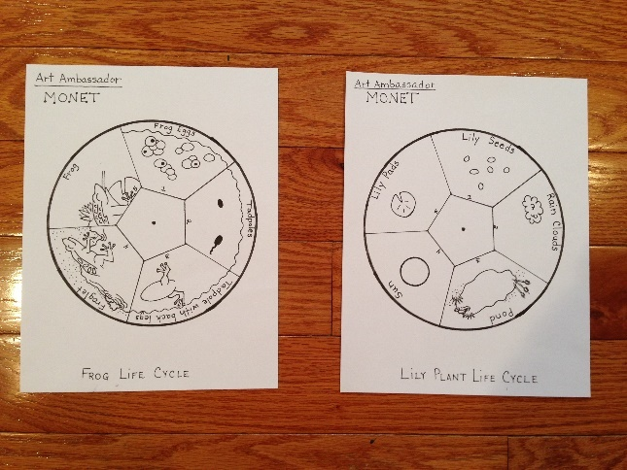
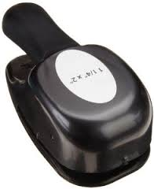
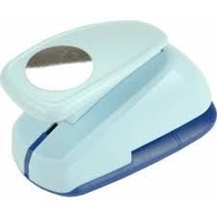
1st Grade Art Ambassador: Claude Monet
Supply Photo
package of nails &
bag to hold brass pins
“Extra Room” box
Paper
plates
2/student
(2) Blow dryers
25-trays or
Paper Bags
“Super Tips” Crayola markers
In container
Sandwich
baggies (for Frog kits)
(25) Sharpie
markers
Clothespins
(25) Black ink
pens
(4)
squirt bottles
Construction paper
Pink & Green
Brass
pins
BIG Glue
for volunteers
Glue for students
Template
for TOP plate
Coffee filters
LIFE CYCLE MASTER copies:
Lily and Frog (also on jpeg.)
(25)“WORK PLATES”
scissors
(2) Paper punches:
(1) Large Oval
(1) Small round

Slide 5
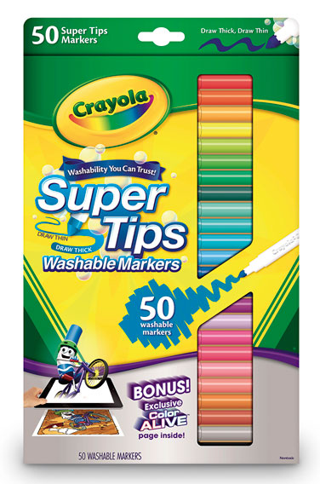
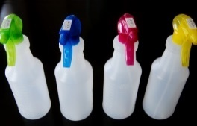
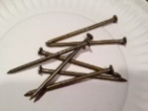
1st Grade AA: Claude Monet
SUPPLY LIST:
WALMART:
Brass pins: (1) per student (regular size, not the real long ones)
Coffee filters: SIZE: MUST BUY the 3 ¼” BASE size. (1) per student
Wooden clothes pins (1) per student
Ziploc Sandwich bags (75+): to create “FROG KITS” ; (1) per student
Glue sticks: (4) JUMBO LARGE ones
PAPER PLATES (all white); just the simple ones, made by WALMART!! Each student gets (2)
TARGET: (Only if you need them)
(1) 50 count of CRAYOLA SUPER TIPS ---- ONLY BUY THIS BRAND and TYPE
MICHAEL’S: check 2nd grade AA storage bin before buying…
GREEN construction paper (frog body and legs); 50 ct. - use coupon
PINK construction paper (frog tongue); 50 ct. – use coupon
Items to borrow, gather, and/or find in 1st grade’s AA storage bin: might need to purchase/replace
(25) Sharpie permanent markers; 1 per student; CHECK TO MAKE SURE THEY WORK!
(25) Black ink pens; so students can draw the lily life cycle.
(25) paper plates labeled “WORK PLATES”; for placing coffee filters on and squirting with water
Cafeteria Trays or GROCERY BAGS (25) --- students use to color on top of, to protect desks from markers
EXTRA ROOM BOX (with these contents):
(2) Blow dryers: makes the drying go faster and MIGHT NEED EXTENSION CORD
Scissors: (2) pairs
(4-6) JUMBO GLUE STICKS
(2) TOP PLATE templates
(12) STUDENT glue sticks: bring some for students who don’t have one.
(4) Squirt bottles: VIP: check to make sure they work.
BAG with (2-3) nails/tools to make holes & BRASS PINS: Nails to put holes thru two paper plates before you insert the brass pin in classroom – ADULTS ONLY
CONTAINER OF “Super Tips” Crayola markers: (3) for each student. VIP: Check to make sure they are not dried out!!
Pink construction paper (creates frog’s tongue)
Green construction paper (creates frog’s body, his legs AND lily pads)
Small Circle paper punch (to create (3) lily pads per student)
LARGE Oval paper punch (frogs body)
MASTER COPIES or jpeg. of “LILY LIFE CYCLE” and “FROG LIFE CYCLE” - send to Printer at Barker Rd Middle School ASAP!
TO COMPLETE THIS PROJECT, STUDENTS WILL NEED: black Sharpie marker (AA provides), colored markers (AA provided), glue stick, pencil (curls the frog’s tongue), black ink pens (AA provides), and colored pencils
ONLY
buy this brand and type

Slide 6
1st Grade AA: Claude Monet
TIME LINE:
PURCHASE SUPPLIES ASAP:
Check for left over supplies in the grade’s AA container.
Purchase needed supplies. See “Supply List”
Prep ASAP
JANUARY:
Contact Lead Teacher and request they pick some dates for their AA and let you know.
Can schedule back to back, but need about a 15-minute window.
Project is done in the classroom + ONE EXTRA ROOM (confirm with Main Office its availability)
Once ok’d by Main Office, confirm with Lead Teacher the dates and times
Complete “Room Reservation Form” if necessary.
Get MASTER COPY or PDF file to Printer at Barker Rd Middle School (complete form too)
MONTH BEFORE PROJECT:
Post for volunteers; works best with (4-5) Volunteers; school express or Volunteer Coordinator and use an eform if an option. Let them also know dates & times of projects AND TRAINING DATE too.
If an option, contact PTSA Web Leader and request an eform be activated on the PTSA AA page for volunteers. Let them know the dates & times of projects AND TRAINING DATE TOO.
If an option, email Room Parents and request they send email to parents requesting volunteers and include the eform link.
All prep should be done by this point.
BUNDLE/ORGANIZE all supplies by class.
Figure out your TECH, check for compatibility, cables, screens, etc. and assure it’s all going to work properly.
Make arrangements to TRAIN Parent Volunteers
Determine who will be the Lead AA Person to do the Introduction Monet PowerPoint.
Train Lead AA People: demonstrate project and mention main pointers and/or problems and tell them where supplies are
BE SURE the 5-cycle page (from Printer) that shows the “Frog” or “Lily Plant” Life cycle has been cut out; 1 per student
1-2 WEEKS BEFORE PROJECT:
Train Volunteers: demonstrate project, mention main pointers and/or problems and show them where supplies are.
Send email to volunteers to “Thank them for Volunteering”, INVITE THEM TO TRAINING, and include the following:
The times & dates of ALL the grade’s AA projects + times & dates of TRAINING.
If necessary, ask Volunteers to consider covering for other classes if low on volunteers
Attach last few pages of the “Prep” PowerPoint that’s labeled “Volunteer Duties”.
LINK for the video which shows how the project is done.
Email the Custodian Manager (and/or Cafeteria Manager) if you’re near their areas or need anything for the project.
KNOW and TEST YOUR TECH
CHECK TO MAKE SURE YOU HAVE ALL SUPPLIES and they are bundled per class.
Email teachers and confirm project (dates & time). NEVER forget to do this!
To complete project students will need: a GLUE STICK and Black Sharpie Marker.
Put note in “EXTRA ROOM” window so others know AA will be using, list the times & dates.

Slide 7
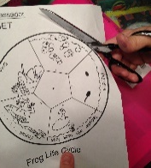
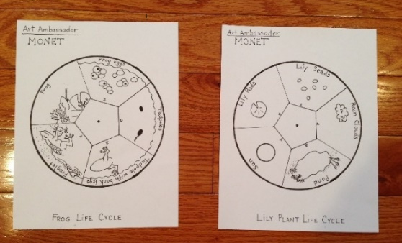
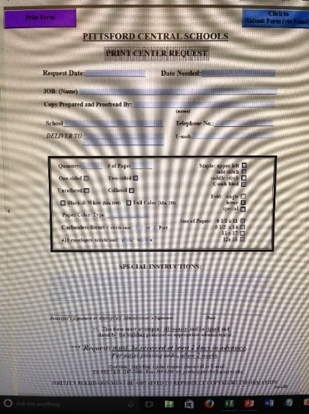
PREP: 1 of 4
1st grade AA: Claude Monet
PRINT & PREP bottom PAPER PLATE:
the 5-cycle FROG or LILY PLANT LIFE CYCLE page:
ASAP… Lead Teacher needs to pick either the “Frog Life Cycle” or “Lily Plant Life Cycle” for the grade.
Send their choice to BRMS Printer; need 1 per student
ONCE life cycle is RETURNED FROM PRINTER:
Cut out the circles; 1 per student
GLUE to center of a white paper plate. Students won’t have time during project.
PICK only ONE
PTSA has a fund to get copies charged to them.
The form is the following link.
http://www.pittsfordschools.org/files/filesystem/PrintShop%20Request%20Form.pdf
The copying is done by Ed Pretko, District Printer, Room 306 Barker Rd. Middle School. You can get copies picked up at the Print Shop or arrange for it to be at your school. He prefers pdf files. His email is Ed_Pretko@pittsford.monroe.edu and his phone is 267-1086.
Email & request copies be returned to your attention at your school:
There is NO CHARGE…. but you must give advance notice!
Complete Printer Request Form and attach jpeg.
Print on plain WHITE COPY PAPER
He will cut and separate into bundles for each class amount.
The hours are: 7:30-12 and 12:30-3:30 M-F.

Slide 8
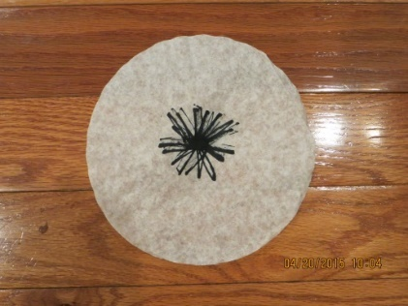
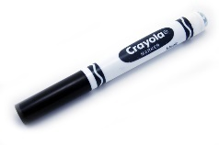
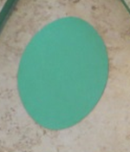
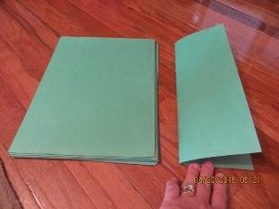
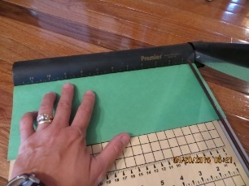
1st grade AA: Claude Monet
PREP: 2 of 4
PREP COFFEE FILTERS: each student gets (1)
Create black “spider” in center of each coffee filter.
Using BLACK CRAYOLA marker ONLY, draw a small sharp spidery star shape in the center. Looks like a squiggle, so the students can copy it’s shape when they do their races.
CREATE LILY PADS: each student gets (3)
GREEN construction paper
Using the SMALL CIRCLE PUNCH, cut out enough so that each student gets (3)
With a pair of scissors, cut out a small wedge from each so they look like lily pads. Approx. (50) circles from 9x12 sheet.
CREATE FROG BODY: each student gets (1)
GREEN construction paper
Use the LARGE OVAL PUNCH
MAKE FROG’s PINK TONGUE: each student gets (1)
PINK construction paper; have to cut down
Take 9x12 pink construction paper; cut down to (2) 4 ½ x 12 sheets
Then using cutter; cut ¼” strips that are 4 ½ inches long; (1) per student
Students will use their pencils in class to roll pink paper around pencil, to get a curly pink tongue
CREATE FROG LEGS : each student gets (2) SETS of frog legs
GREEN construction paper; have to cut down
Your paper is probably 9x12; so about 2-pages makes enough frog legs for 1-class
FOLD IT FIRST ! Fold in half (the LONG way) so now it’s 4 ½ “ x 12” long.
Using a cutter (one in PTSA meeting room in cafeteria), cut into , ½” strips.
If Art Ambassador doesn’t have a portable paper cutter, check to see if the school has one you can use
fold

Slide 9
1st grade AA: Claude Monet
PREP: 3 of 4
CREATE “FROG KITS”:
(1) per student
Don’t hand out frog parts in class… make the kits. It takes too long to hand them out in class, causes confusion, and pieces easily get lost.
EACH ZIP LOCK BAGGIE SHOULD HAVE THE FOLLOWING:
(1) Green large oval for the frog’s body
(2) Green strips folded in half (frog’s 2-sets of legs)
(1) Pink frog tongue
(1) clothes pin (students glue frog to it)
(3) Lily pads
(4) SPRAY BOTTLES: Volunteers ONLY
Be sure to fill them up with water prior to the project.
Makes sure they are on MIST for project (it only takes a little bit of water, 4-5 light squirts)

Slide 10
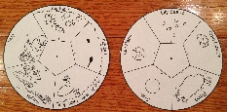
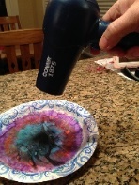
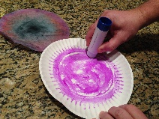
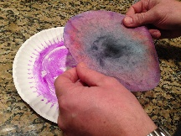
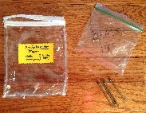
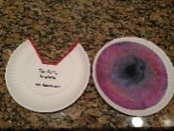
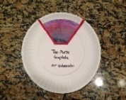
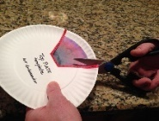
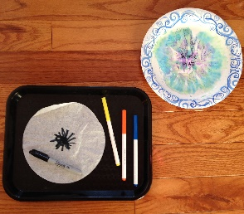
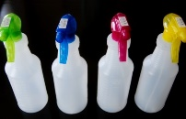
1st grade AA: Claude Monet
PREP: 4 of 4
DAY OF PROJECT
This project uses (3) PAPER PLATES:
(#1) “Work Plate”
(#2) 5-cycle glued to a PLATE (bottom)
(#3) Colored filter glued to a PLATE (top)
TAKE TO CLASSROOM:
TAKE TO EXTRA ROOM:
(25) Trays
(25) plates that are labeled “Work Plates”
--- should be in 1st grade AA storage bin
Box of Markers
Black Sharpie markers; 1 per student
Coffee filters with black squiggle in center; 1 per student
LONG POSTER that shows the 3-races
(4) spray bottles filled with water
AFTER “Monet Introduction PowerPoint” hand out
FROG KITS; 1 per student
Black ink pens; 1 per student
Life Cycle Plate with glued (Frog or Lily Life Cycle); 1 per student
SAMPLE of PROJECT to show AFTER the “Monet Introduction” PP
PACKAGE which should INCLUDE:
(3-4) nails/hole punch -to poke holes through both plates
BRASS PINS; 1 per student –to connect the two plates
(25) REGULAR white paper plates; 1 for each student
Volunteers after drying student’s colored filter, will glue it to this plate. This becomes the “Top Plate”.
“EXTRA ROOM BOX” (which should include the following items)
(2) blow dryers
(2) pairs of scissors
(3-4) JUMBO glue sticks
(2) TEMPLATES for cutting the TOP plate
Part 1A
Part 1B
see all of
the above
(15 min.)
Part 1A
see above
Volunteers blow dry each colored filter
Glue each colored filter to a plane white paper plate
Place TEMPLATE over newly created “Top Plate” and cut out the wedge. Don’t cut off student’s name.
RETURN TO CLASS ROOM ASAP

Slide 11
MONET TRAINING: Let volunteers know problem spots (YOU TOO)
An “EXTRA ROOM” is used in this project so that the TOP plate can be prepped; tell them where the room is.
Show example of actual project. Monet style water garden showing the Lily Life Cycle or Frog Life Cycle with a MONET FROG.
Explain THREE “Drawing Races” done at the very beginning & SHOW “DRAWING RACE POSTER” to help explain. This is the same poster students will see………. VIP!!!! THESE 3-DRAWING RACES are DONE VERY FAST!
1st race: 1st color around the black squiggle on the filter. (“Did anyone see who won? I didn’t, so let’s do another race!”)
2nd race: 2nd color around the first (“Did anyone see the winner again?! Oh man! Me neither… let’s do another race!”)
3rd race: 3rd color around the last one (“You guys are all SUPER fast, nice job…. Now put your filter on the colorful used plate and we’ll come around and squirt it with some water.” ONLY MIST WITH WATER, about 4-5 squirts!
AFTER DRAWING RACE: (2) Volunteers go to the “Extra Room” to prep the colored filter while the other Volunteers stay in the room:
blow dry filter (2-dryers in room; use different outlets, could BLOW the fuse in room!!!!)
glue to paper plate
use TEMPLATE to cut out a wedge (Don’t CUT STUDENTS NAME OFF!!)
Return to CLASS with dried plates
match up to student’s 5-CYCLE (BOTTOM PLATE) to the colored filter PLATE
push nail/hole punch through both plates
Push brass pin through hole so the plates now spin.
DURING “Introduction” to MONET, need to hand out “Frog Kits” and 5-sectioned Life Cycle glued to paper plate; a drawing the students complete
Important that trays/paper bags on desks BEFORE students come in, or do it in the hallway and bring in ASAP. Each student will also get a “WORK PLATE” that needs to be placed off to their side. Colored filter goes on and then squirt with water 5-7x
AA Lead doing the presentation may have to speed up or slow kids down in order to buy time for the filters to be returned to the classroom; add mustache, add hat, polka dots, racing stripes, etc.
TRAINING
A volunteer needs to show the “DRAWING RACE” poster sheet to the STUDENTS….. VIP!!!!!
Helps students get a sense for space and outcome
Also important that they color A LOT and not leave a lot of white between their coloring

Slide 12
1st grade AA: Claude Monet
PROJECT OUTLINE:
Lead AA Person ONLY
1 of 2
BRING PROJECT SAMPLE to all classes + DRAWING RACE example (LONG poster with colored filters on it)
MAKE SURE water bottles have water in them and they are at MIST!!!
SET-UP:
ARRIVE 30-minutes BEFORE scheduled time of project to TRAIN volunteers and set-up. Ask VOL to arrive 20-minutes ahead.
ASAP, each student gets on their desk: ask volunteers to do the following
ONE TRAY: with the following items: each students gets ONE
(1) coffee filter with black squiggle in middle
(3) Crayola markers; make sure they are different colors
(1) black sharpie
(1) “WORK PLATE”
MAKE SURE YOU HAVE THE “EXTRA ROOM BOX” …. and…. TAKE IT TO THE EXTRA ROOM!!!!
Inside should be: (2) Blow dryers, (2) pairs of scissors, (2) top plate templates, (4) Jumbo glue sticks, + (25) PAPER PLATES!
Set up your TECH
Bring glue sticks: Teacher’s forget and student’s always run out; 1 per student
Figure out which volunteers are going to do the “Extra Room” duties; works best with (2-3) Volunteers in Extra Room
Need to also bring: circular 5-cycle sheet (“Frog” of “Lily Plant” Life Cycle), package of nails AND BRASS PINS (1 per student)
(3) DRAWING RACES (step 1): DO VERY QUICKLY BEFORE MONET INTRODUCTION !! 10-15 minutes
CAREFUL! Students must color on trays or markers will bleed onto their desks.
Ask Students put their name close to the edge of their coffee filter, using their BLACK SHARPIE marker.
Ask Volunteers to COLLECT SHARPIE markers.
SHOW STUDENTS long poster with COLORED filters so they get idea of the “Drawing Races”
RACE #1: Pick 1st color, scribble around BLACK squiggle
RACE #2: Pick 2nd color (should be different than 1st) and scribble around color they just did.
RACE #3: Pick 3rd color, scribble around and go to the edge of the filter.
Tell Students to put their colored filter onto their WORK PLATE & raise their hand so a vol can come over and squirt their plate a couple of times with water. Ask students… “What happens??”
ASK PARENT VOLUNTEERS TO SQUIRT student’s filters with water (about 4-5 light squirts)
Let students see how the colors run.
Ask VOL to collect trays/paper bags PLUS FILTERS, by stacking and take all to the EXTRA ROOM (15-MINUTES): where they will blow dry & glue filter to TOP plate, cut wedge using TEMPLATE, return to class & match up plates plus brass pin.
STEP 1:

Slide 13
1st grade AA: Claude Monet
PROJECT OUTLINE:
Lead AA Person ONLY
2 of 2
INTRODUCTION: Claude Monet Introduction PowerPoint (10 minutes)
Ask VOLUNTEERS to hand out ONE to each student:
5-cycle PAPER PLATE with either the “Frog” or “Lily Plant” glued to it
(1) FROG KIT
(1) BLACK INK PEN
PROJECT: SHOW STUDENTS SAMPLE OF THE PROJECT and tell them they already did STEP #1 ! Coloring “FAST” just like Monet did!
STEP 2: Lily Life Cycle or Frog Life Cycle + MONET FROG + PADS: 20 minutes
Point out the real pictures on the screen, and then show them the SAMPLE of the project again so they can get some ideas of how to finish the drawings. Ask students to complete the drawing on their plate. They will use their “IMPRESSION” of the 5-CYCLES (Lily Plant or Frog Life), There’s NO getting this wrong, it’s their impression of what they see in the real photos.
STEP 3: CREATE “Monet” FROG: 10-15+ minutes
TELL STUDENTS TO GET OUT GLUE STICK and a PENCIL
OVAL: draw eyes, ridges, bumps, glasses, warts, dots, spots, on their frogs
FOLD up (2) GREEN strips like a fan, then rip them in half, so we have 4-legs (SHOW STUDENTS HOW TO DO)
CURL pink paper around a pencil to make the tongue (SHOW STUDENTS HOW TO DO)
NOW GLUE: legs and mouth to BOTTOM side of frog
NOW put a lot of glue onto the clothespin and stick their frog on top (make sure his mouth is at the mouth opening of the clothespin)
VIP: Might need to extend time if plates aren’t back.
VOLUNTEERS will RETURN with TOP PLATES, match to student’s 5-cycle & punch hole thru both with nail & add brass pin.
6. Student’s glue (3) LILY PADS to their TOP PLATECLIP frog to the TOP plate so it will spin properly.
FINAL STEP:
STUDENTS should color in their Lily Plant or Frog Life Cycle with colored pencils (their bottom plate)
THANK VOLUNTEERS and TEACHER
ASK STUDENTS: What did they learn from Art Ambassador today?
Tell me something you learned about Claude Monet?
FROG LIFE CYCLE (Instructions for Lead AA to tell students)
Frog eggs (draw more circles with dots)
Tadpoles (oval with squiggles for a tail)
Tadpole with back legs (add long tail, add eyeball, add some bumps, a smile!)
Froglet (add smaller tail, add bumps, ridges, and eyes)
Frog (add frog’s eyes, ridges, bumps, warts, and EATING something good)
LILY PLANT LIFE CYCLE (Instructions for Lead AA to tell students)
Lily Plant seeds (draw more seeds)
Rain clouds (add more clouds, add some rain & lightning)
Pond (add ripples, add a fish swimming in it, give him some air bubbles)
Sun (add a smile, some sunglasses, and some fancy rays)
Lily Pads (add a couple more that look like “Pac Man”)

Slide 14
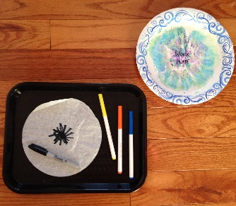
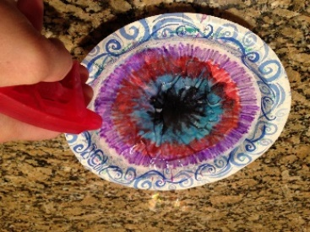
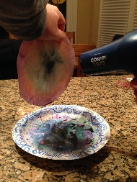
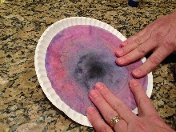
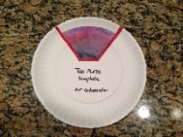
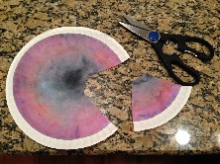
1st grade AA: Monet
Lead AA & Volunteers:
“How To”: 1 of 2
STEP 1: Part A, in class
ASAP:
ONE Tray
(3) markers
(1) Sharpie
(1) filter
(1) Work Plate
Have (3) “Drawing Races” on one filter
(show poster below, to students)
Volunteers will do 4-5x squirts only!
STEP 1: Part B, in Extra Room Volunteers are prepping colored filters; drying, gluing to a plate, cutting a wedge, and returning them to classroom
In “EXTRA ROOM” (2-volunteers are doing the following, while students see Monet Introduction:
If the “Extra Room” is being used (for what ever reason) and you need a back-up plan…. Go to the PTSA storage room and be sure to bring the ELECTRICAL cord.
Blow dry each colored FILTER, approximately 35-55 seconds. They dry faster if you hold them up in the air. USE DIFFERENT ELECTRICAL PLUGS, or we could blow circuits… done it before.
After it’s DRY…. Glue each colored filter to a PLAIN WHITE PAPER PLATE. Be sure to glue along the first curve of the plate so the filter sticks really well.
Place “TOP PLATE” TEMPLATE over the plate you just created (one with the student’s colored filter) and follow the CUT OUT. Be careful not to cut off the student’s name!
Take plates back to the classroom (as soon as you have about half of them done. THEN JUMP IN AND START HELPING STUDENTS with project

Slide 15
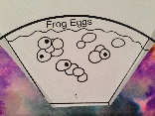
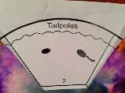
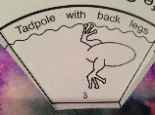
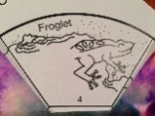
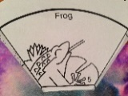
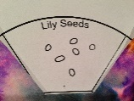
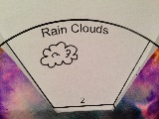
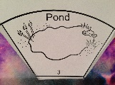
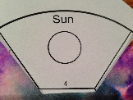
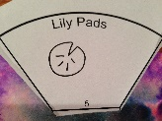
1st grade AA: Monet
Lead AA & Volunteers:
“How To”: 2 of 2
Step 2: In class, students will complete drawing THEIR IMPRESSION - of a Frog or Lily Plant Life Cycle, CUT IT OUT, and then glue it to a plate
Instructions for Lead, to tell students how to finish drawings is on Introduction PP, Monet.
OR
Step 3: In class, students will complete Frog Kit
Usually at this point, Volunteers return & match the COLORED TOP PLATE to student’s
5-cycle plate (bottom plate that they drew). Volunteers now use a NAIL to punch a hole into both plates & insert a brass pin.
SEE PICS BELOW for Step 4
Color with colored pencils
Step 4: VOL from Extra Room now return to classroom and do the following while students are still finishing their MONET frogs
ONLY ADULT VOLUNTEERS should be using NAIL and BRASS PINS

Slide 16
1st grade AA: MONET
Volunteer Duties: 1 of 2
ARRIVE 20-MINUTES BEFORE scheduled start time of project for TRAINING and to help SET-UP
ASAP: (2) Volunteers:
GET (25) TRAYS: place one at each student’s desk
Place (1) coffee filter on each tray
Place (1) black sharpie marker on each filter (to write their name with)
(2) Volunteers: (put on each tray)
Give each student a “WORK PLATE”
Place (3) Crayola Washable markers (different, contrasting colors)
(3) DRAWING RACES:
STUDENTS will see a 10-minute Introduction on Claude Monet
DURING Introduction: (1-2) Volunteers should hand out ONE to each student:
(1) “FROG KIT”
(1) 5-sectioned Life Cycle BOTTOM PAPER PLATE
(1) BLACK INK PEN.
PROJECT: ALL VOLUNTEERS:
Encourage students how to complete drawing of their 5-cycle BOTTOM PLATE and throw away their scrap paper after they cut
HELP students when they CREATE MONET FROG:
Suggest to students to draw glasses, warts, dots, spots, mustaches, beauty marks, racing signs, etc.
Might need to help and/or show students how to bend the legs of the frog like they’re making a fan.
Make sure they use A LOT OF GLUE on clothespin, then stick frog to it.
THE MOUTH of the clothespin should also be the nose of the frog
Might have to show some students how to curl the tongue around a pencil; TONGUE is also glued underside of frog
Show students to CLIP frog to the TOP plate so it will spin properly.
Work
Plate
AFTER STUDENTS WRITE THEIR NAME:
(1-2) Volunteers: collect black sharpie markers after students do their name
(1) Volunteer: show the LONG poster with the colored filters so they can get an idea of of the drawing races. See PIC to left.
THREE DRAWING RACES will be played by the AA Lead Person: (10-15 min.)
ALL VOL: help with the DRAWING RACES by encouraging and watching to make sure students are doing a lot of coloring
AFTER the 3rd RACE (their 3rd color and the filter will be all colored now)
(2-4) Volunteers: Make sure filter is on “work plate”… then squirt 4-5x ONLY! Don’t saturate and let students see colors run & mix
AFTER STUDENT’S SEE HOW THE COLORS RUN and MIX:
(1) Volunteers: collect ALL THE colored markers and place back into their container AND NOW STAY with students.
(2-3) Volunteers:
collect the WORK PLATES… AND LEAVE student’s filter still on them, just stack them up gently
take to the EXTRA ROOM
do the EXTRA ROOM PREP (see next page)
Show LONG poster

Slide 17
1st grade AA: Monet
Volunteer Duties: 2 of 2
(2) Volunteers in “EXTRA ROOM” (about 15-minutes):
If the “Extra Room” is being used (for what ever reason) and you need a back-up plan…. Go to the PTSA storage room and be sure to bring the ELECTRICAL cord.
Blow dry each colored FILTER, approximately 35-55 seconds. They dry faster if you hold them up in the air. USE DIFFERENT ELECTRICAL PLUGS, or we could blow circuits… done it before.
After it’s DRY…. Glue each colored filter to a PLAIN WHITE PAPER PLATE. Be sure to glue along the first curve of the plate so the filter sticks really well.
Place “TOP PLATE” TEMPLATE over the plate you just created (one with the student’s colored filter) and follow the CUT OUT. Be careful not to cut off the student’s name!
Take plates back to the classroom (as soon as you have about half of them done.
BACK IN CLASSROOM with FINISHED TOP PLATE:
Match your colorful TOP PLATE with the student’s 5-part Life Cycle BOTTOM PLATE
Place colorful PLATE on TOP of the Life Cycle Plate
CAREFULLY… hang plates over edge of desk and use large NAIL/hole maker to push a hole through the center of both plates. Plates are still a little damp, so this will take a little pressure.
Place the brass pin in the hole to secure the two plates together.
Leave on student’s desk.
NOW HELP STUDENTS with the remainder of the project AND HAVE FUN!

