Slide 1
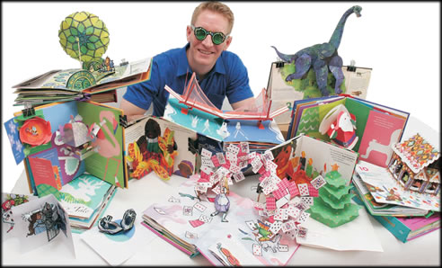
Robert Sabuda, Paper Artist
By: Teri Allart

Slide 2
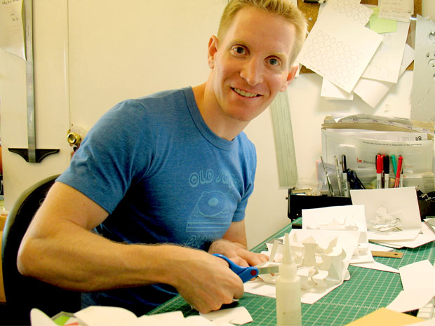
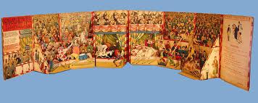
Robert Sabuda works from his studio in New York City.
He has illustrated 19 children’s books, created 20+ pop-ups earning him the Meggendorfer Prize, three times from the Movable Book Society of America.
Pop up books aren’t new…
we can date their history back to a 1306 Astrological book.
Originally they were written for Scholars, Doctors, Scientists…
“ADULTS ONLY”

Slide 3
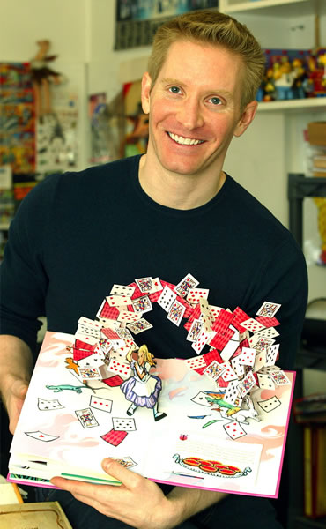
Once upon a time…
At around age 8, Robert was sitting in a new dentists’ office. His Mom suggested they read some of the books in a basket.
He found some hardcover books, which he knew were expensive. Upon opening one it turned out to be a pop-up book. He had never seen one before and he was AMAZED at what looked like MAGIC!
His father was a mason and carpenter and his Mom owned a dance studio and worked as a secretary for Ford Motor Co.
Sabuda combined his love of construction and the visual arts into his new found desire to make art move! He practiced his skill on the old manila office folders his Mom brought home from work.
Robert Sabuda
“Paper Engineer”

Slide 4
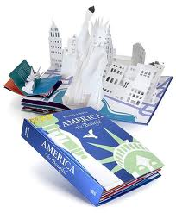
America The Beautiful
A pop-up book by
Robert Sabuda
Carefully and gently, please enjoy looking at Robert’s book and then pass it to a friend.
This book puts the classic American anthem "America the Beautiful" into movable art.
It’s all done in his typical style of using stunning white for his pop-ups.
Please find the “Statue of Liberty” pop-up in the book !

Slide 5
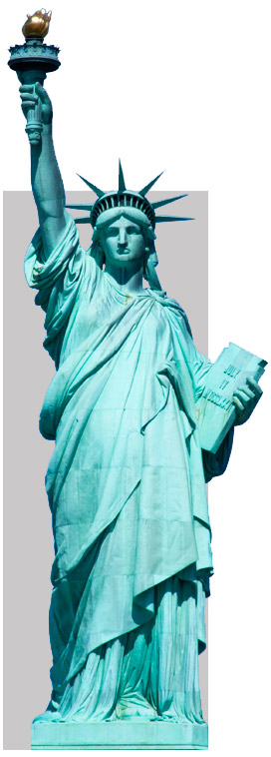
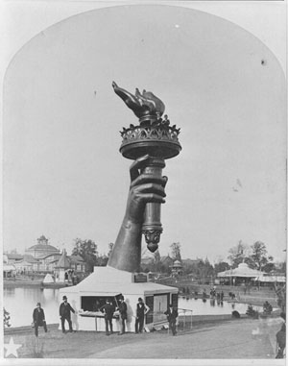
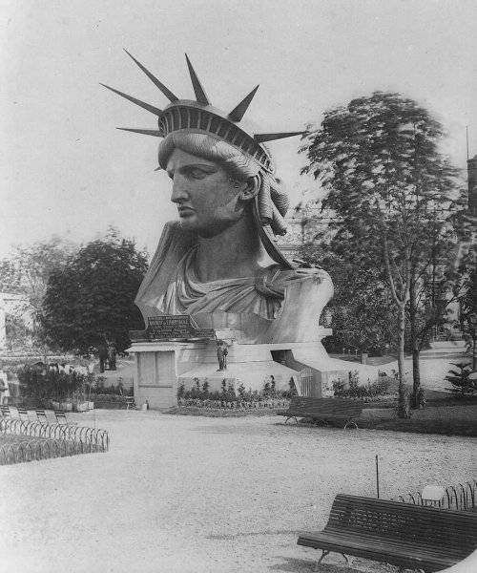
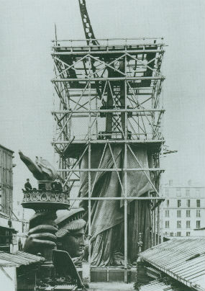
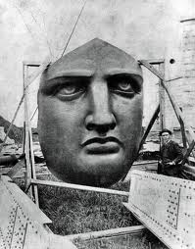
Édouard de Laboulaye (1865) --- Had an “IDEA” !
Came up with the idea to give the statue as a gift to the United States. He hoped it would inspire France to want the same freedoms as written in our Declaration of Independence
“That all men are created equal.”
Frederic-Auguste Bartholdi (1870) --- DESIGNER
Originally he called her “Liberty Enlightening the World.”
French crews worked around the clock, 7-days a week, for
9-years! She was disassembled into 350 pieces, shipped to NY City, and took 4-months to put her together again.
Her torch lights the way to freedom. The tablet she holds, dated July 4, 1776, is our Declaration of Independence.
Alexandre-Gustave Eiffel (1875 - 1885) ENGINEER
Created the iron framework underneath the copper plating. He then built the Eiffel Tower for Paris's World Fair in 1889.
Universal symbol of
FREEDOM & DEMOCRACY
She is the first to welcome many immigrants who move away from their countries to settle in the United States.

Slide 6
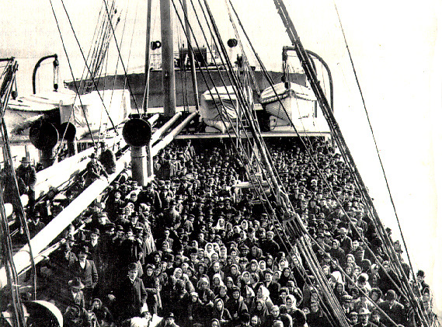
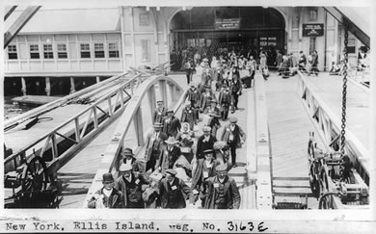
Immigrants came because…
They wanted to ESCAPE :
Poverty
Crop failure, famine and/or drought
No jobs
Bad political conditions
Persecution or intolerance
Lack of freedom
Shortage of farmland
Struggling or failing economy
Wars in their homeland
They HOPED for:
Freedom to choose religious beliefs
Better opportunities
More opportunities; jobs, pay, purchase land
Join friends and relatives who had already moved to the United States
To build a new nation
Chance at a better life for themselves and their families

Slide 7
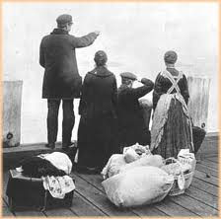
Most early immigrants arrived in New York City with only the clothes on their back. Some brought a small trunk or bag of their belongings which might include:
Passports
Photos
Religious items
Address of a relative
Cherished object
Cherished papers
Books
Clothes
Thimble
Needle
Thread
Medicine
Money
More Importantly
IMMIGRANTS
brought …
Knowledge
Skilled Craftsmanship
Traditions
Culture
History
Recipes
ANSWER: to get a job
Why would Immigrants bring…
thimble, needle and thread to the United States?

Slide 8
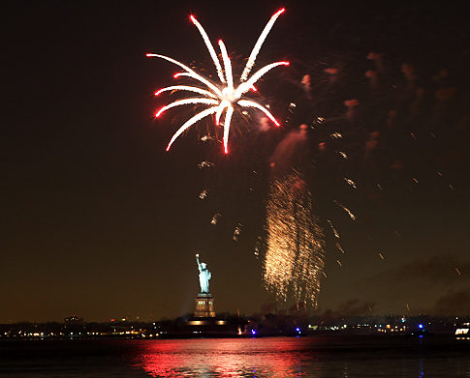
A cold and misty day, the Statue of Liberty was unveiled on Bedloe's Island in New York Harbor and dedicated amid great public celebration.
New York City declared a general holiday, and Brooklyn closed its schools.
As crowds cheered, horns blared, ships' bells rang out, and fireworks filled the air.
President Grover Cleveland formally accepted the gift from the people of France to the people of the United States.
This copper clad statue of a crowned woman, remains the best known symbol of freedom in the world.
October 28, 1886

Slide 9
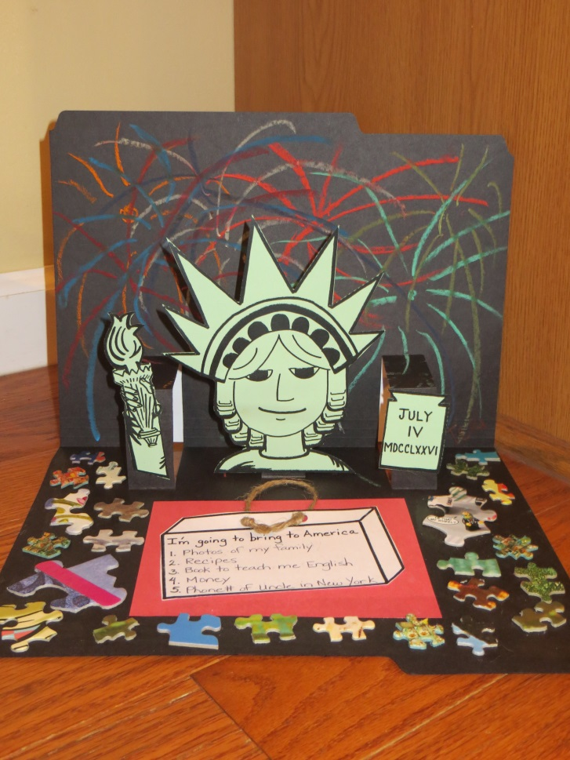
Art Ambassador Project:
Statue of Liberty
POP-UP
You will be given:
Office folder
Oil pastel crayons
Paper Statue of Liberty
Black ink pen
Paper suitcase
Puzzle pieces
Your Talents page
You will need:
Scissor
Glue stick
Colored pencils
Your fun side
In the style of
Paper Artist and Book Maker,
Robert Sabuda

Slide 10
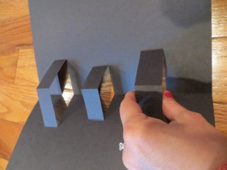
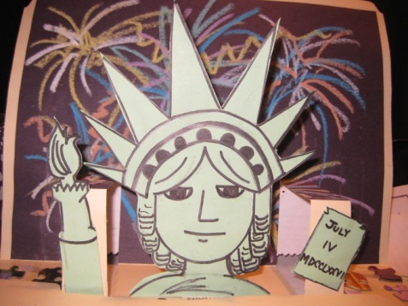
Step 1
Step 2
DRAW some FIREWORKS !
Use several different colors of the oil pastels to create a nighttime scene of fireworks in the sky.
Once you’re done, raise your hand and we’ll bring you a wipie to clean your hands.
CUT ALONG THE DOTTED LINES of your green pop-up template.
GENTLY pull up the tabs on the inside of your black folder.
Put some glue on the FRONT of these tabs. (Don’t glue the backs of the green pieces).
Place your green pieces slightly above the fold (of the tab), so it pops up easily.
Glue TORCH to HER RIGHT hand.
Glue LADY LIBERTY to the center tab.
Glue July 4th TABLET to HER LEFT hand.
( 8 & 10: 20 minutes total )

Slide 11
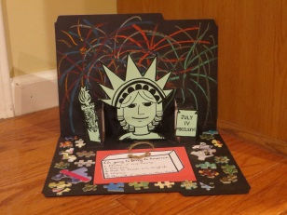
Step 3
Step 4
The puzzle pieces represent
all of us; our dreams, our different ideas, and how we all fit together in the United States.
Using your BLACK INK PEN, write down (5) things you would put in your suitcase to bring to America. These should be all TANGIBLE items (things you can touch).
Glue your suitcase to your colored piece of paper (red or blue)
Glue this entire piece inside your pop-up, below Lady Liberty.
Take your glue stick and start gluing down puzzle pieces to decorate the inside of your pop-up.
HELPFUL HINT: Glue the folder where you want to put the puzzle piece FIRST… then stick your puzzle piece where you just glued.
( 5 & 10: 15 minutes total )

Slide 12
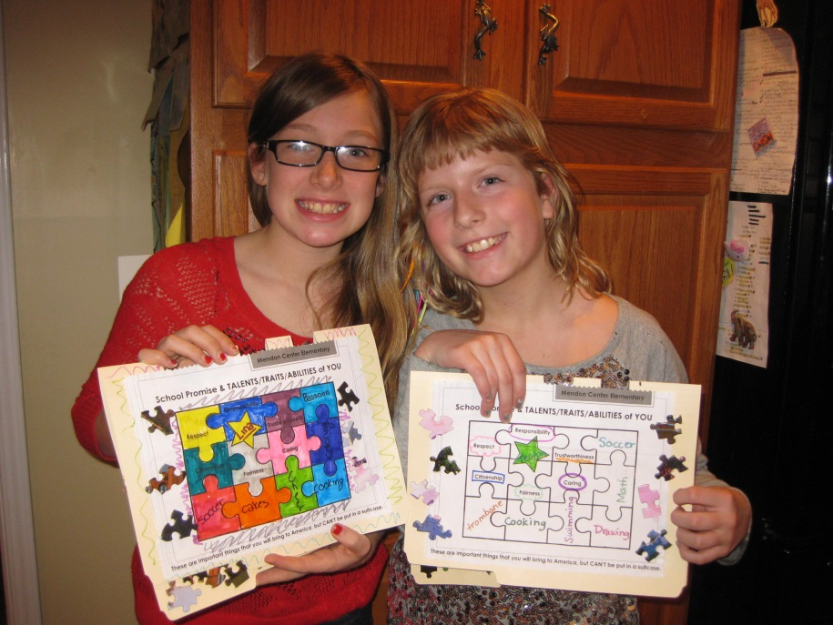
Step 5
Last Step
YOUR SPECIAL
TALENTS
PAGE:
WELCOME to AMERICA !
Write your name in the STAR.
Use the black ink pen and fill the EMPTY PUZZLE PIECES in with traits, talents and special things about you!
These are things you can’t touch
(INTANGIBLE) and can’t be put in a suitcase. An important part of who you are.
3. Glue to the front of your folder.
Now add some style with your COLORED PENCILS !
( 5/+: 5-10 minutes total )

Slide 13
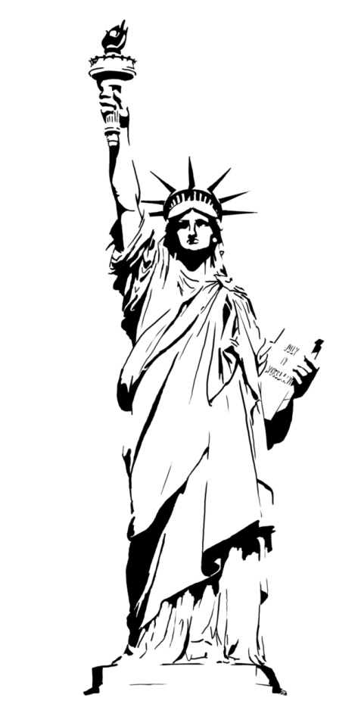
STATUE of LIBERTY TRIVIA
Which HAND does she hold the torch?
What is the tablet that she holds?
Which HAND does she hold the tablet?
What is the date inscribed on the tablet?
What does her torch represent?
What do the (7) spikes on her crown represent?
Why is she GREEN?
Why is the base of the Statue of Liberty shaped like a star?
ADDITIONAL FUN FACTS:
She is 305’ 1” tall (ground to the tip of the flames), as tall as a 22-story building.
Spikes on her crown are 9’ long and weigh 150 lbs. each.
Designer claims her face is the Roman Goddess of Liberty (yet a rumor said it was his Mother).
She faces SE in the NY Harbor so she greets incoming ships.

Slide 14
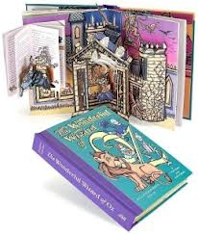
Some of Robert Sabuda’s books:

