Slide 1
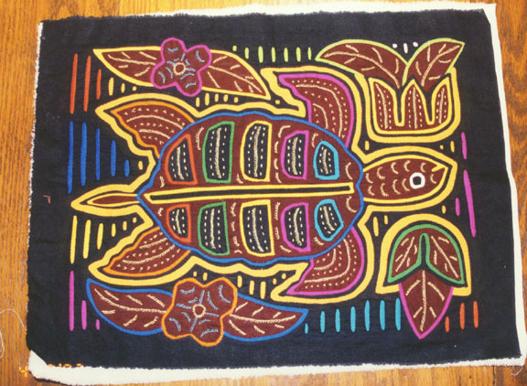
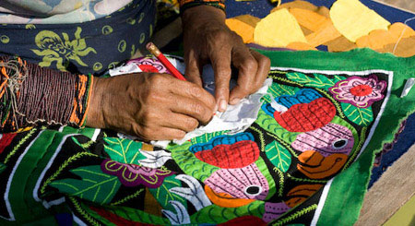
Magnifica
Molas
By: Teri Allart
The Kuna Indians of Panama
Textile Art

Slide 2
San Blas Islands of Panama
The Kuna Indians are a Matriarchal
society and they are the indigenous
people of Panama and Columbia.
Most of the Kunas live on some of
the 378 coral islands off the coast
of Panama.
The Panamanian government tried
to stop their traditional ways, but
the Kuna’s revolted in 1925.
Their treaty allows them to govern
themselves and they now work to
preserve a balance of a traditional way of life
in a world that is becoming more and more modern.

Slide 3
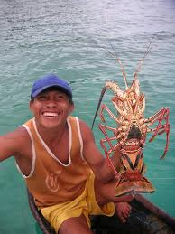
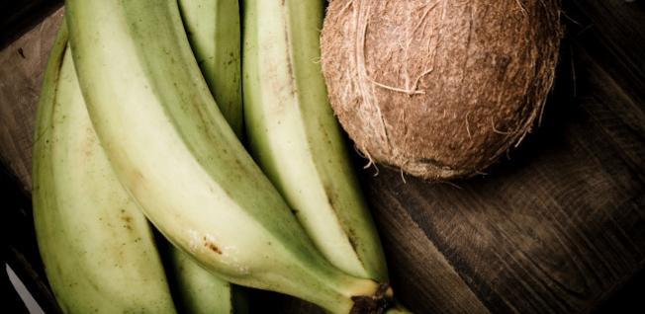
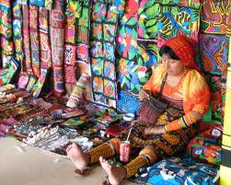
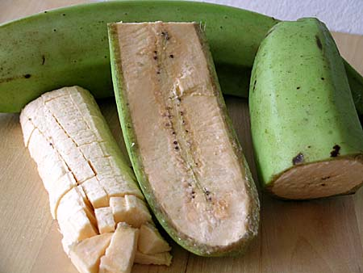
To make a living in the modern world, the Kuna Indians have a long tradition of international trade that includes:
fishing
lobsters
farming coconuts and plantains
creating their famous art called “Molas”
Old World vs. New Coke !

Slide 4
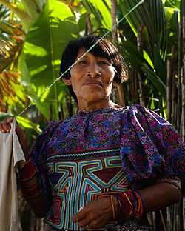
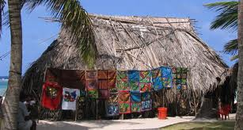
Molas are part of the traditional costume of the Kuna women. Mola means shirt or clothing.
The Kuna Women’s artistry keeps the oral traditions of their society alive.
Kuna girls start sewing Molas (a textile/clothing art) by the age of seven using a method called Reverse Applique.
It can take up to 9 months to complete a Mola.
The Mola is the signature craft of the Kuna Indian women of Panama and is a major source of income.
Tourists value the Molas depending upon size, quality, number of layers, colors and designs.

Slide 5
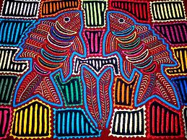
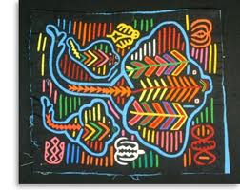
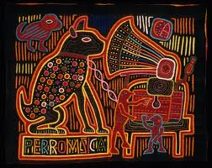
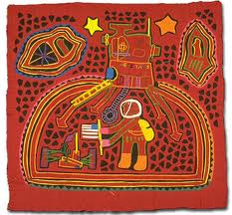
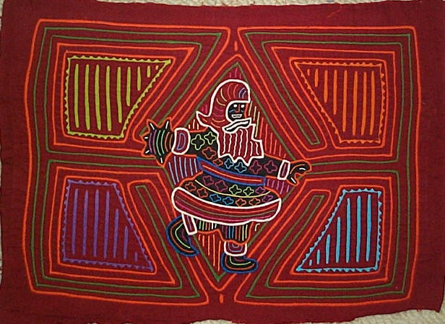
While geometrical patterns are still very popular, the Kuna Women show their world by sewing images of birds, flowers and animals.
Mas Molas…
But… “Dog Music” (RCA), American Rockets and SANTA ??!!
Where are the Kuna Indian Women getting their ideas for their Molas?
.

Slide 6
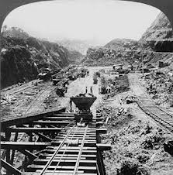
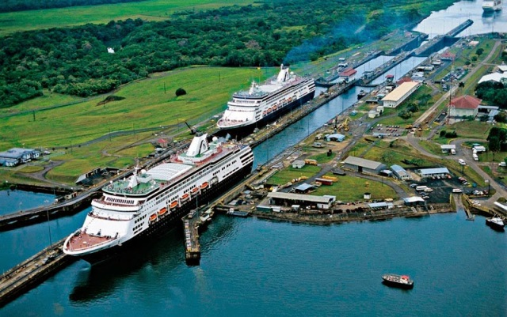
The wealth of images for Molas come from:
Traditions and stories
Natural surroundings (oceans and rain forests)
Animals
Different cultures arriving after the construction of the Panama Canal (Began 1881–1914, continues now!)
Tourists
Magazines
Comic Books
Trademarks
Labels
Advertisements
Kuna Indian Woman “looking”
at Vogue Magazine!
(She can’t read English)

Slide 7
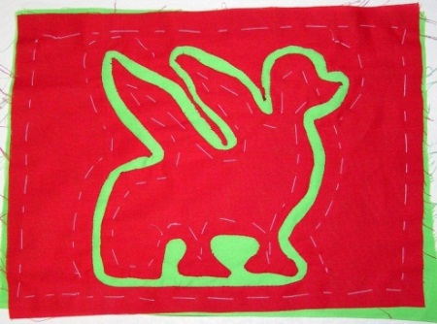
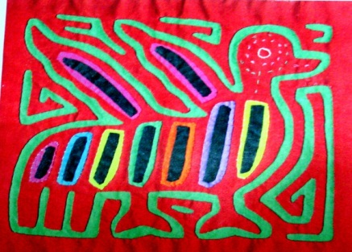
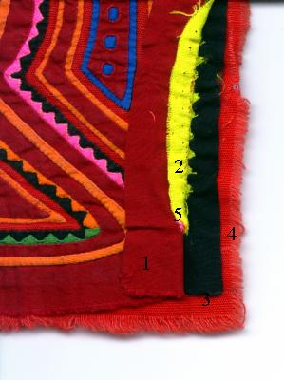
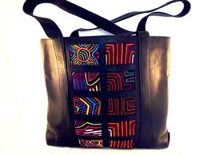
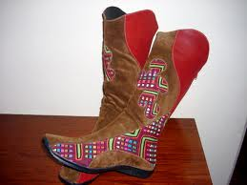
The makings of a Mola
The traditional method of using “reverse applique” is still done today, it’s what gives Molas their layered, colorful look.
It can take 6-9 months to complete some of these beautiful designs that then can be used to decorate…
Shirts
Shoes
Bags
Wall Art
Socks
Pillows
Hats
And more!

Slide 8
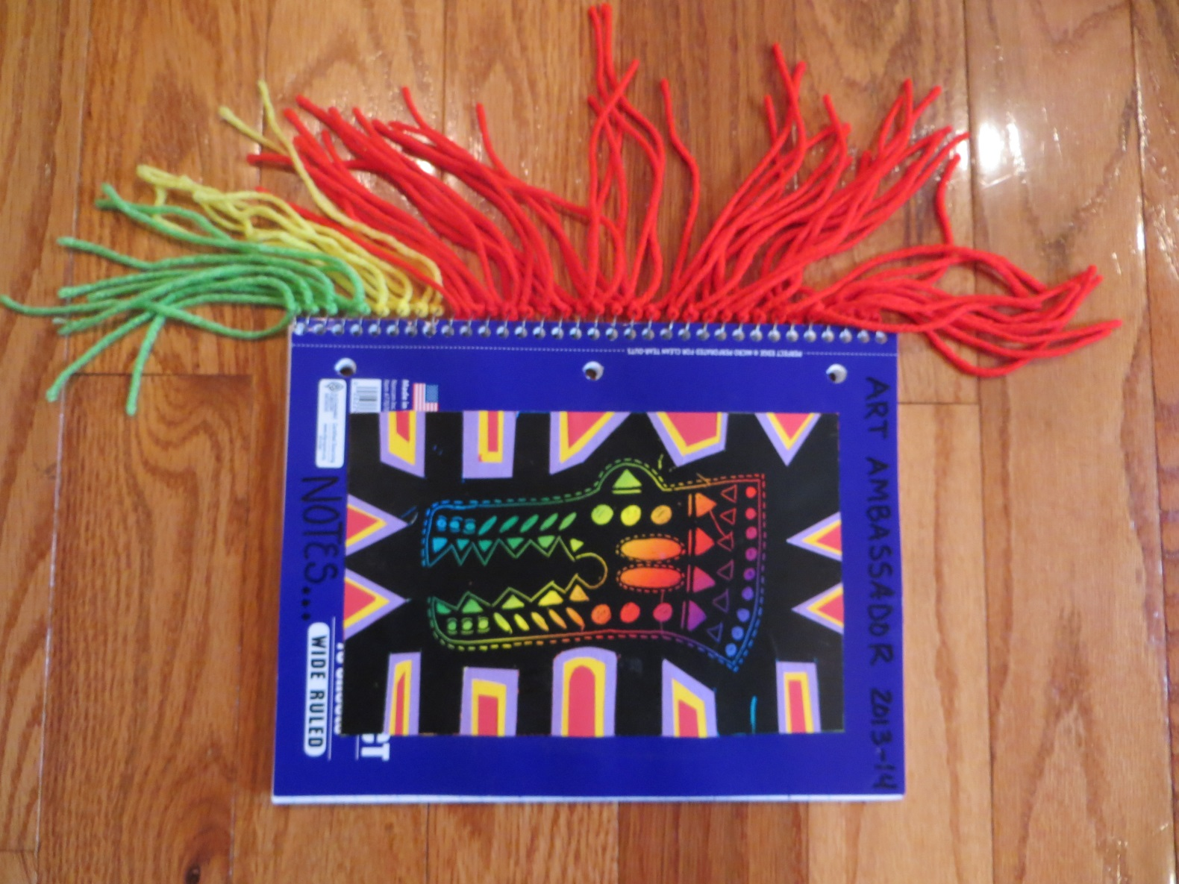
Say “HOLA” to your MOLA project
Art Ambassador:
You are going to create your own
Mola and you will need to get out :
scissors
glue stick
your fun side
You will be given:
stencils
notebook
(1) scratch paper
(1) scratch stick
colored papers
yarn

Slide 9
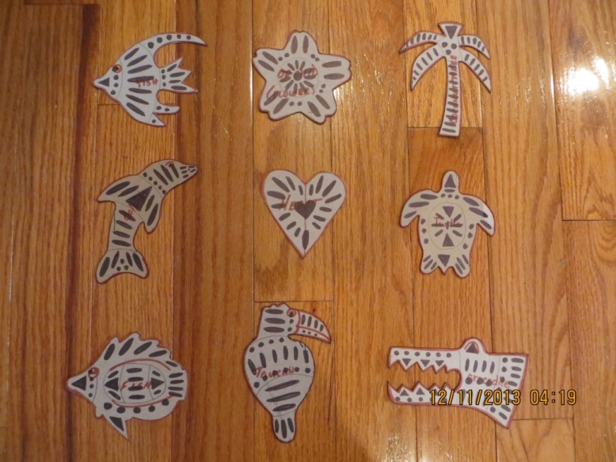
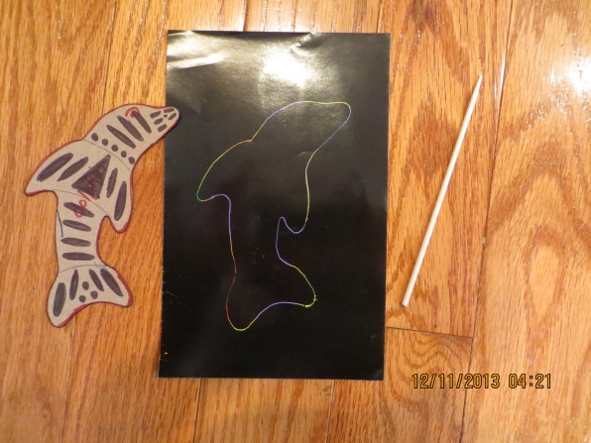
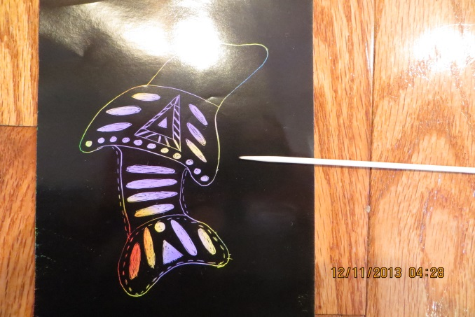
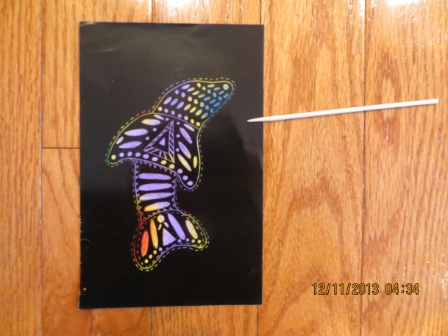
Step 1: 15 minutes
ANIMALS & DESIGNS of PANAMA
Choose ONE stencil please
(2) Fish
Orchid (National Flower of Panama)
Coconut Tree
Dolphin
Heart
Sea Turtle
Toucan
Crocodile
Place your stencil the LONG WAY on your scratch off paper, which is also the LONG WAY (vertical)
Trace your stencil.
Decorate the inside of the stencil with ovals, triangles, squares, etc.
Follow the examples on the stencil OR… think up some of your own designs!

Slide 10
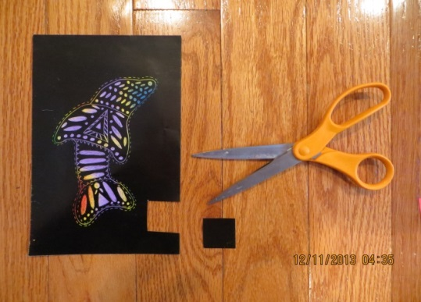
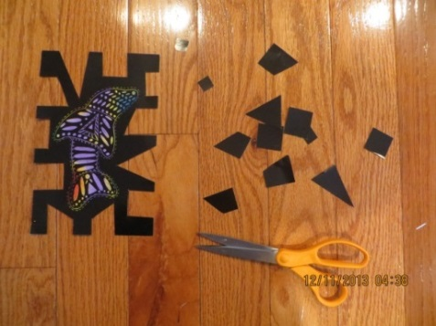
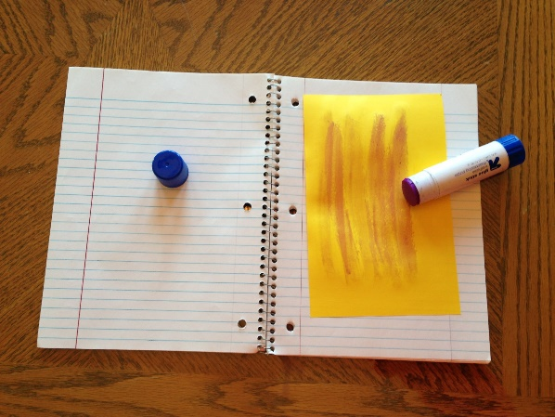
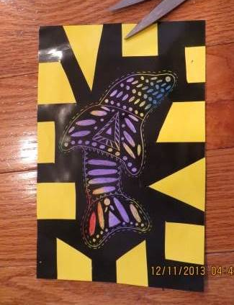
Step 2: 5-8 minutes
Open up your notebook (2-white pages) and use it as a working surface.
Choose ONE piece of colored paper.
Glue the entire FRONT of the colored paper! Don’t glue the back of the scratch off paper, it will rip.
glue
this!
Cut out LARGE shapes (triangles, squares) into the frame.
Important:
Leave the outside framing of the stencil.
Center your Mola stencil and stick it to the colored paper.
Rub it from the back! It will scratch.
DO NOT CUT
THE STENCIL OUT
Part A
Part B

Slide 11
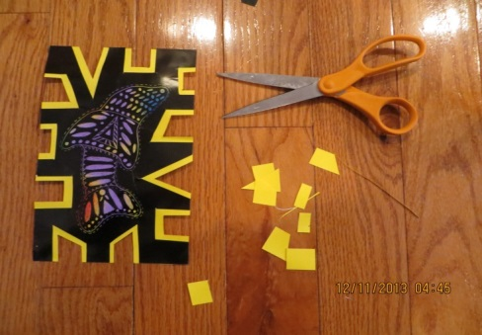
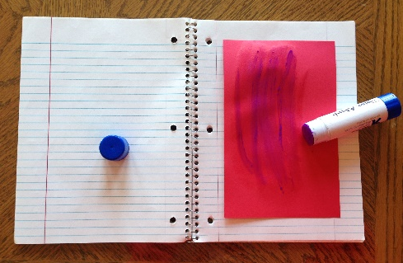
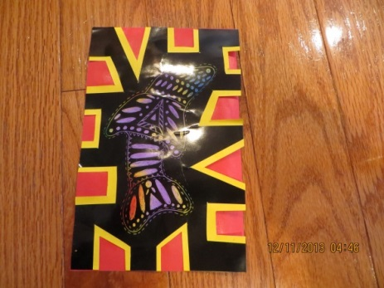
Step 3: 5 minutes
Cut out your shapes again.
BUT… you are cutting them out from the inside of your first cuts, making them just a little smaller.
Leave an outline of the colored paper showing all around.
Choose a SECOND piece
of colored paper:
Glue the entire FRONT of the colored paper (DO NOT glue the back of your stencil).
Center your Mola stencil and stick it to your second piece of colored paper.
Flip it over and rub the back if you want make sure it sticks REAL GOOD!
glue
this!

Slide 12
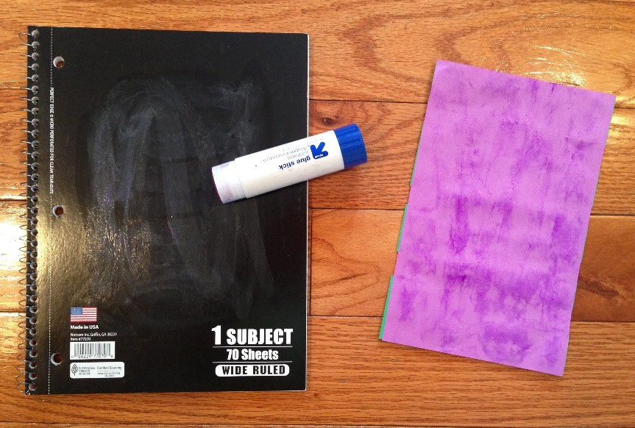
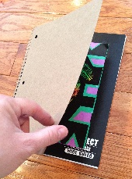
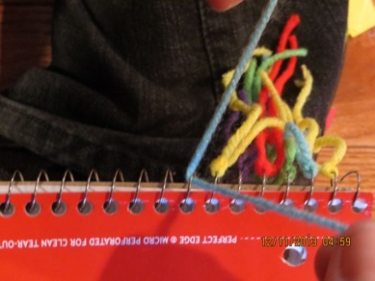
STEP 4 & 5: 5-10 minutes
Glue your MOLA stencil
to your notebook
Glue the BACK of your Mola stencil
AND glue the front of your notebook.
Now stick them together. Don’t rub the Mola!
Trick: Flip back cover of notebook over onto the Mola and rub it.
glue
glue
Finally… add your YARN !
Trick: Hang the notebook off the edge of your desk.
Thread a piece of yarn through ONE spiral.
Make both ends even (like you’re tying your shoe).
Tie two knots, so it won’t slip off the metal.
ENJOY YOUR MOLA !

